Slide 1


NASA Space Grant Arizona
Project ASCEND
(Fall 2025 – Spring 2026)
CGUHS Near Space Research Team
Casa Grande Union High School
Casa Grande, AZ

Slide 2

Near Space Research Team
Project Lead: Landri Howard (CGUHS 2026, ASU 2030)
Electrical Assembly Lead: Hailianna Rodgers (CGUHS 2028)
Programming Lead: Peyton Posey (CGUHS 2028)
Intern: Mylene Luna (CGUHS 2029)
Faculty Advisor: John Morris
2/24

Slide 3
Program Overview
Our Team
Students for the Exploration and Development of Space (SEDS@CGUHS)
Near Space Research Team
Our Mission – Designed. Built. Flown. By us.
The Near Space Research Team will design, construct, program, test, and fly a high-altitude balloon payload to 100,000 feet to gather atmospheric data and 4K video during the flight.
Funding
Operates with funding from the Arizona Space Grant Consortium.
Materials and Supplies
Student Scholarships
3/24

Slide 4
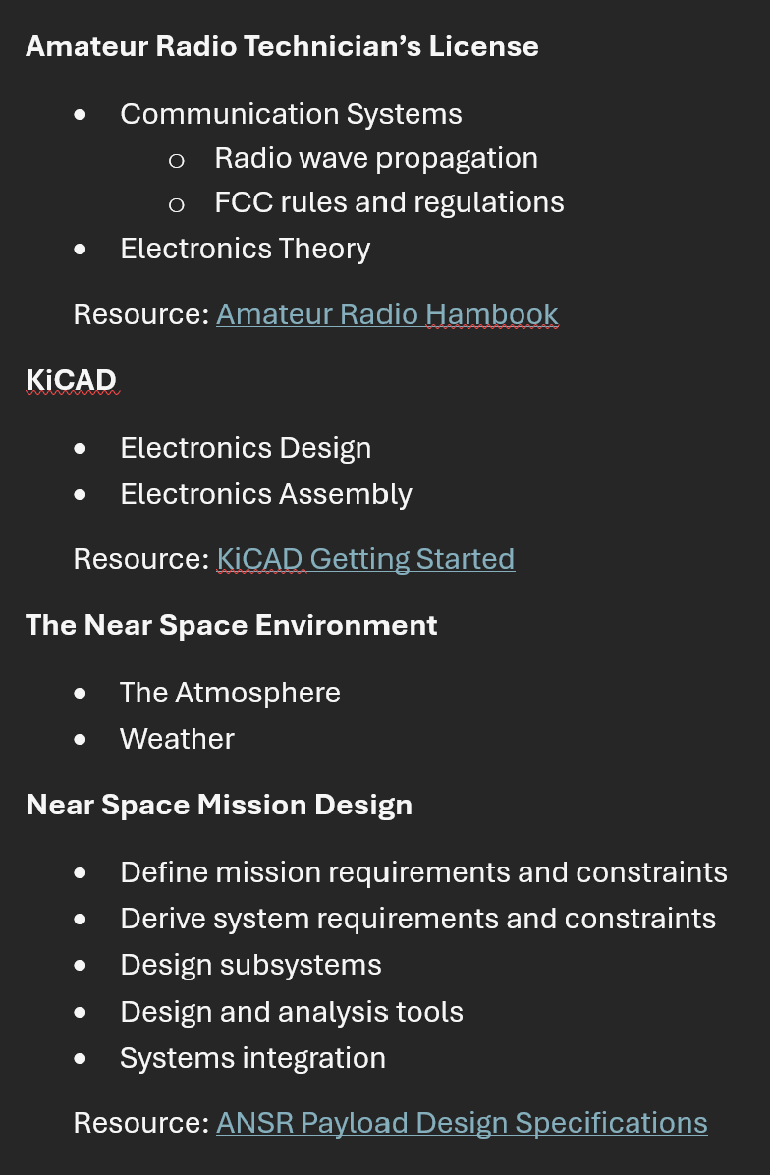
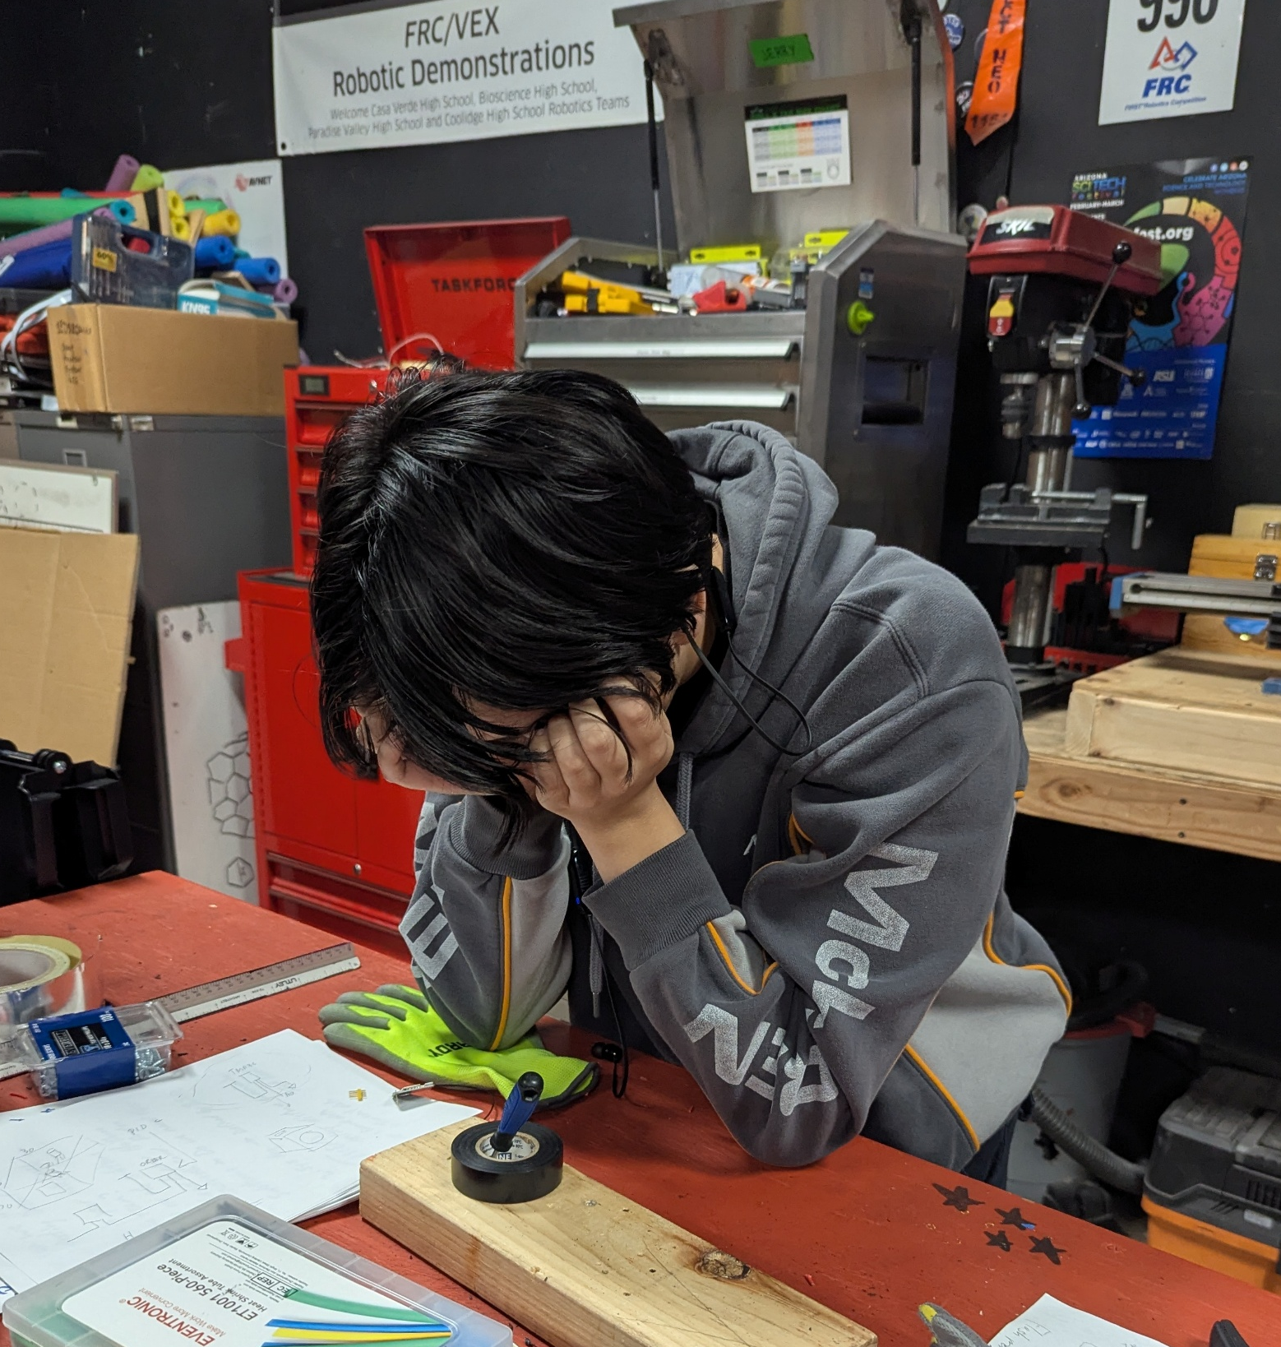
The Plan: A Course of Study
4/24

Slide 5
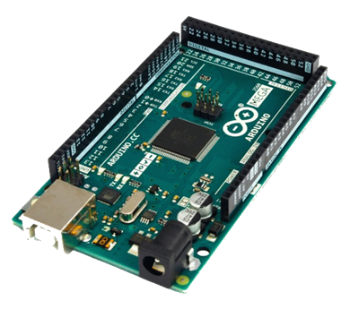
Systems and Foundation Integration
Fall 2025
Core Technical Focus
  Electrical Integration
  Power Management
  Arduino Development
Hardware Profile
  Primary Controller: Arduino Mega 2560.
  Sensors:
  BME280 for pressure, temperature, and humidity
  TMP36 for internal temperature monitoring.
  GUVA S12SD UV Sensor (240-370 nm range)
  NEO – 6M GPS Module
  ZT 110X60 Solar Panel
  Thermal Control: Implementation of a 4.2 W PID-controlled heater system with PID Controlled Closed-Loop Feedback using the Internal TMP-36 signal.
Total mass including lamp rod and batteries: 1.31 kg (2.89 lb)

Slide 6

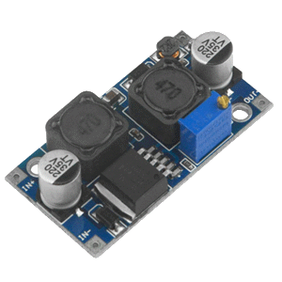
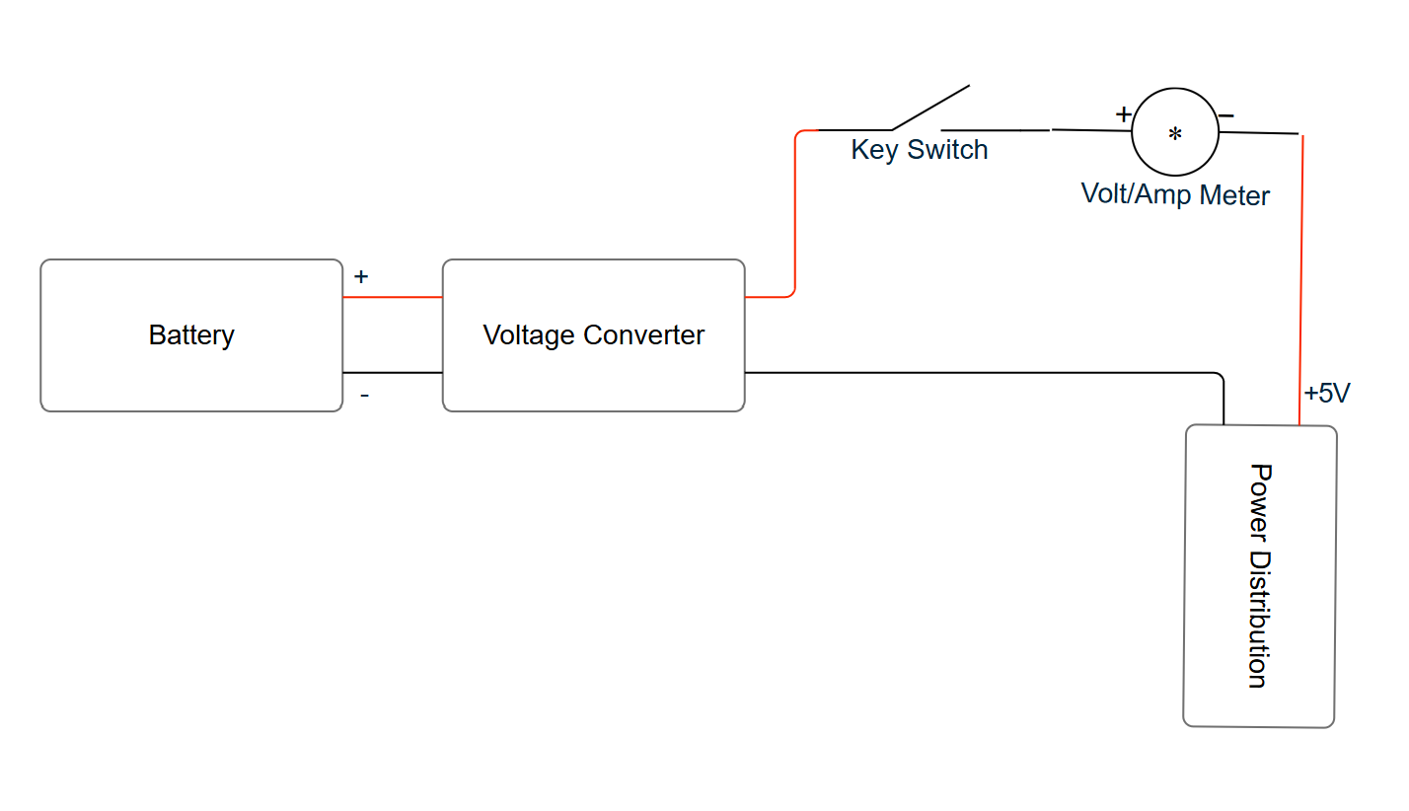
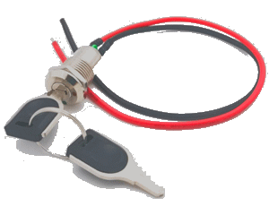
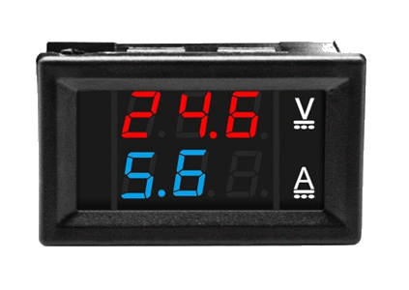
Simple Regulated Power Supply
6/24

Slide 7
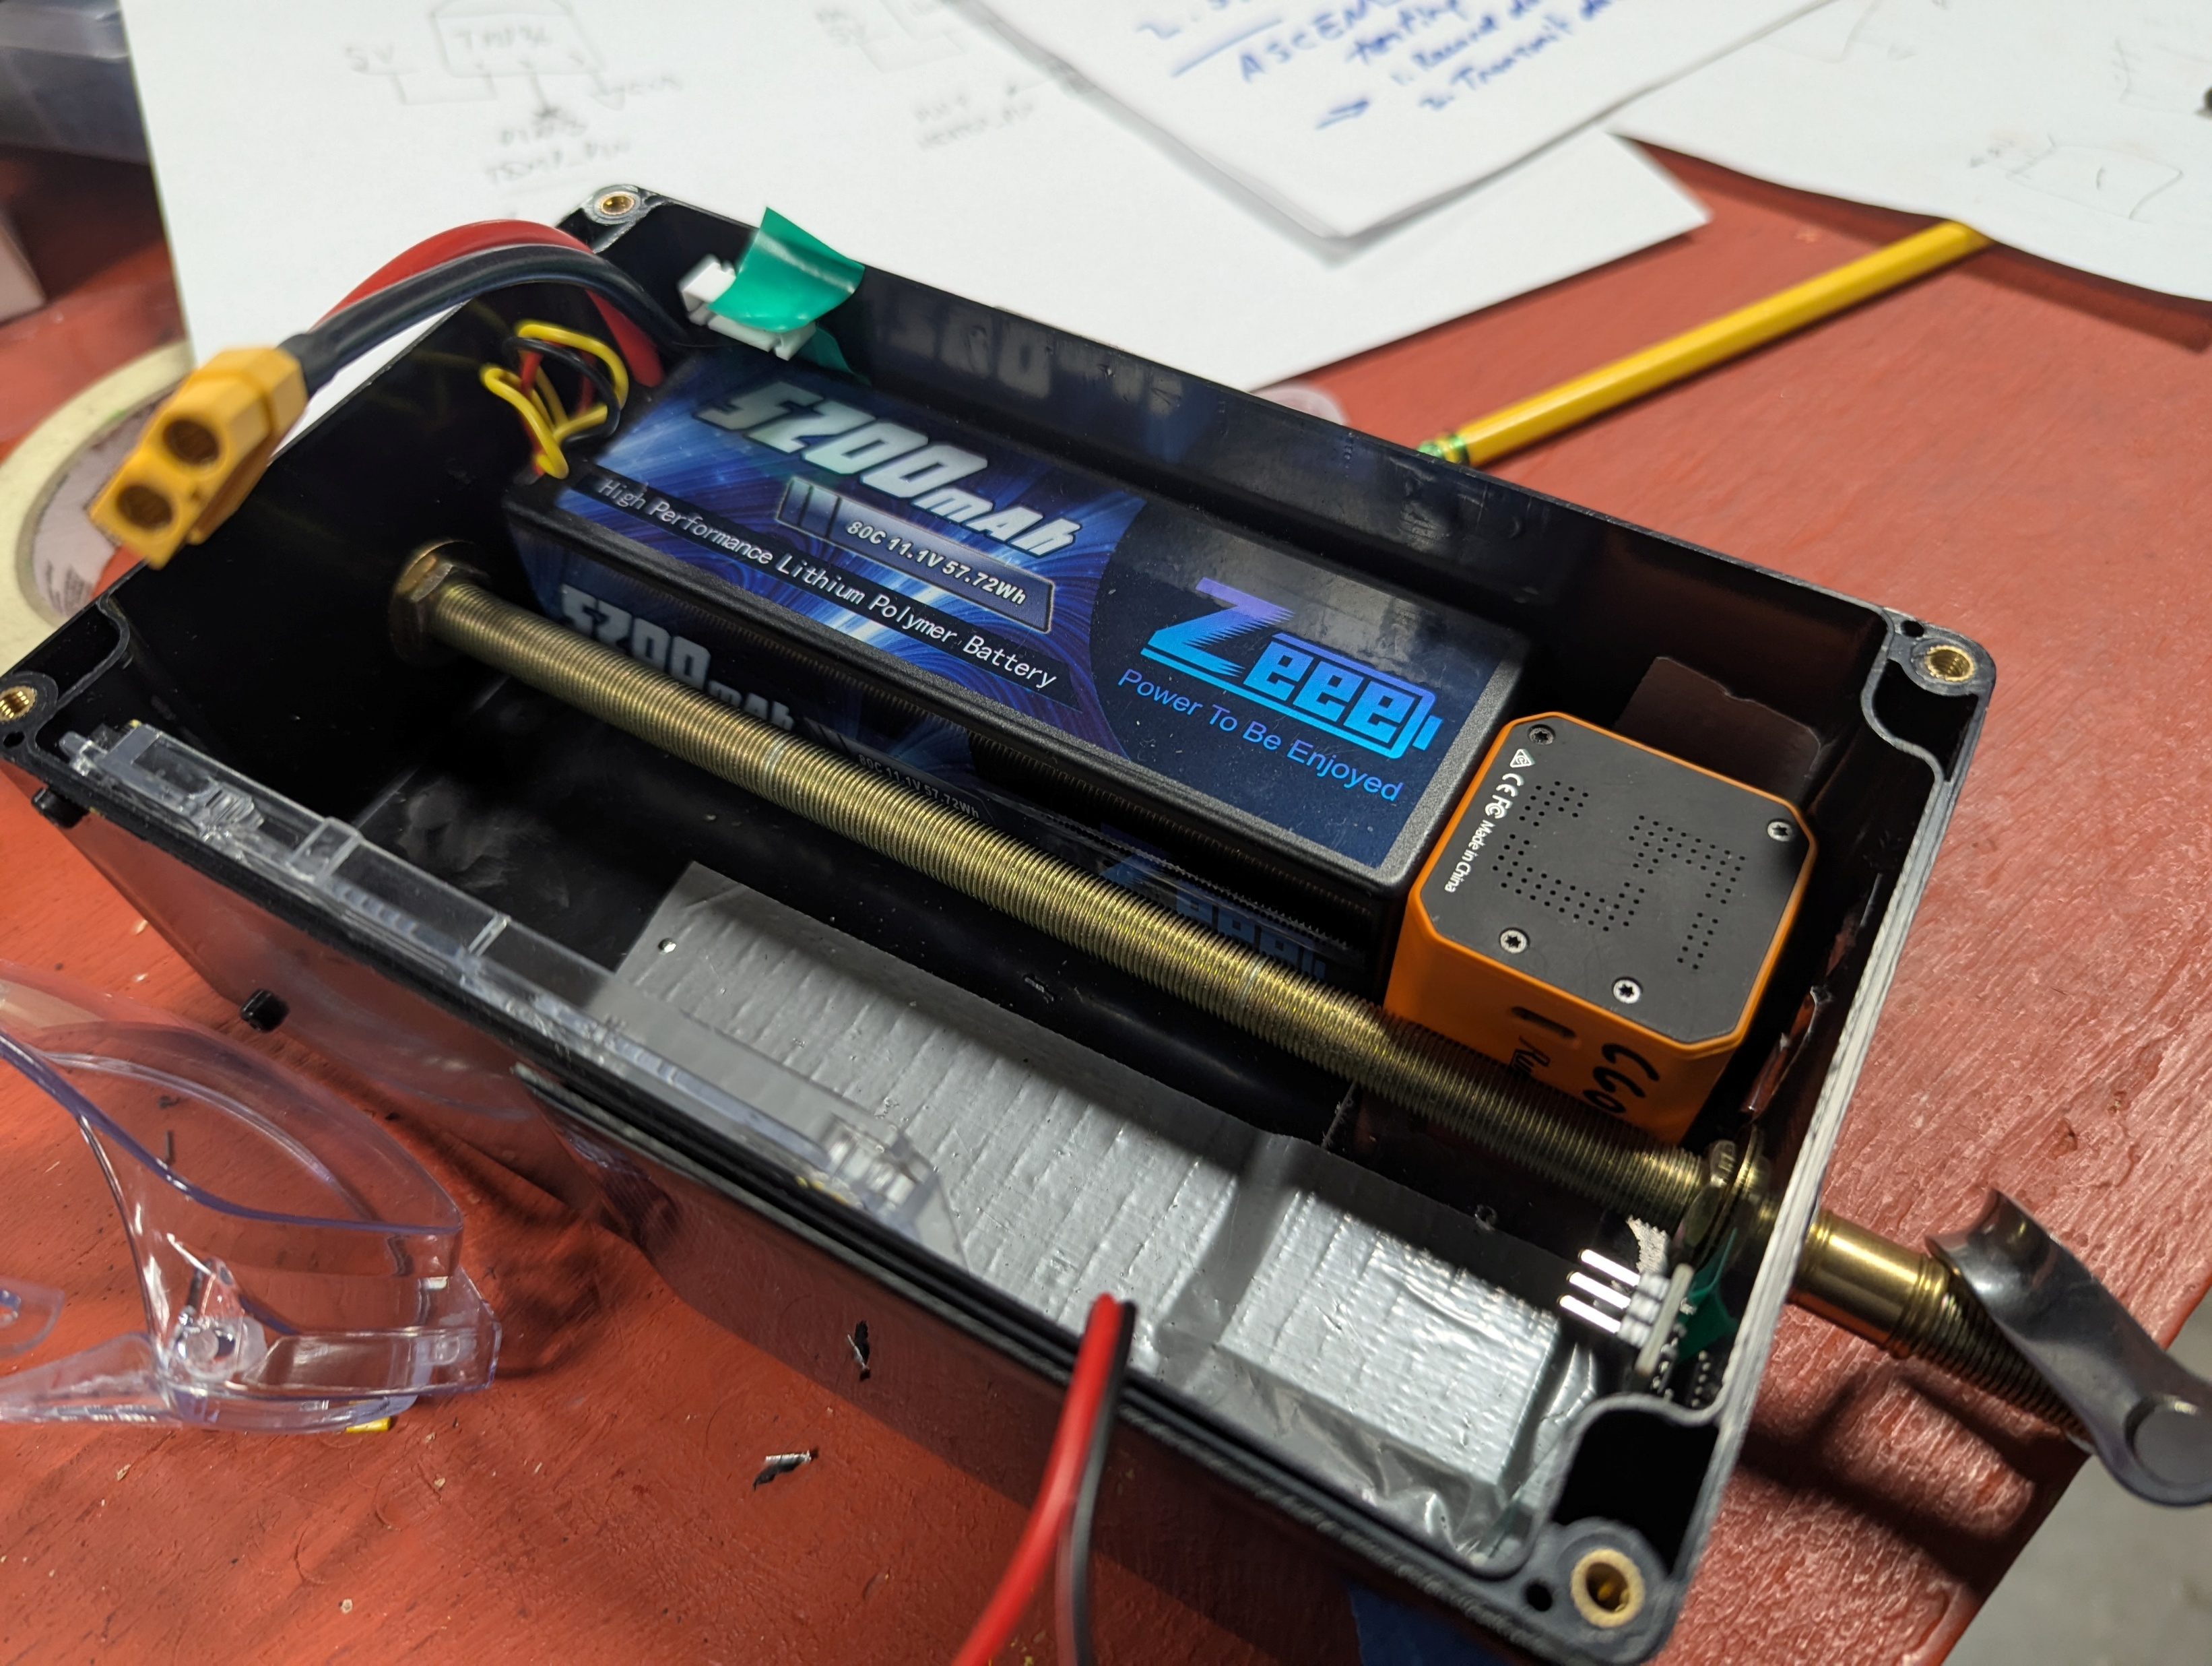
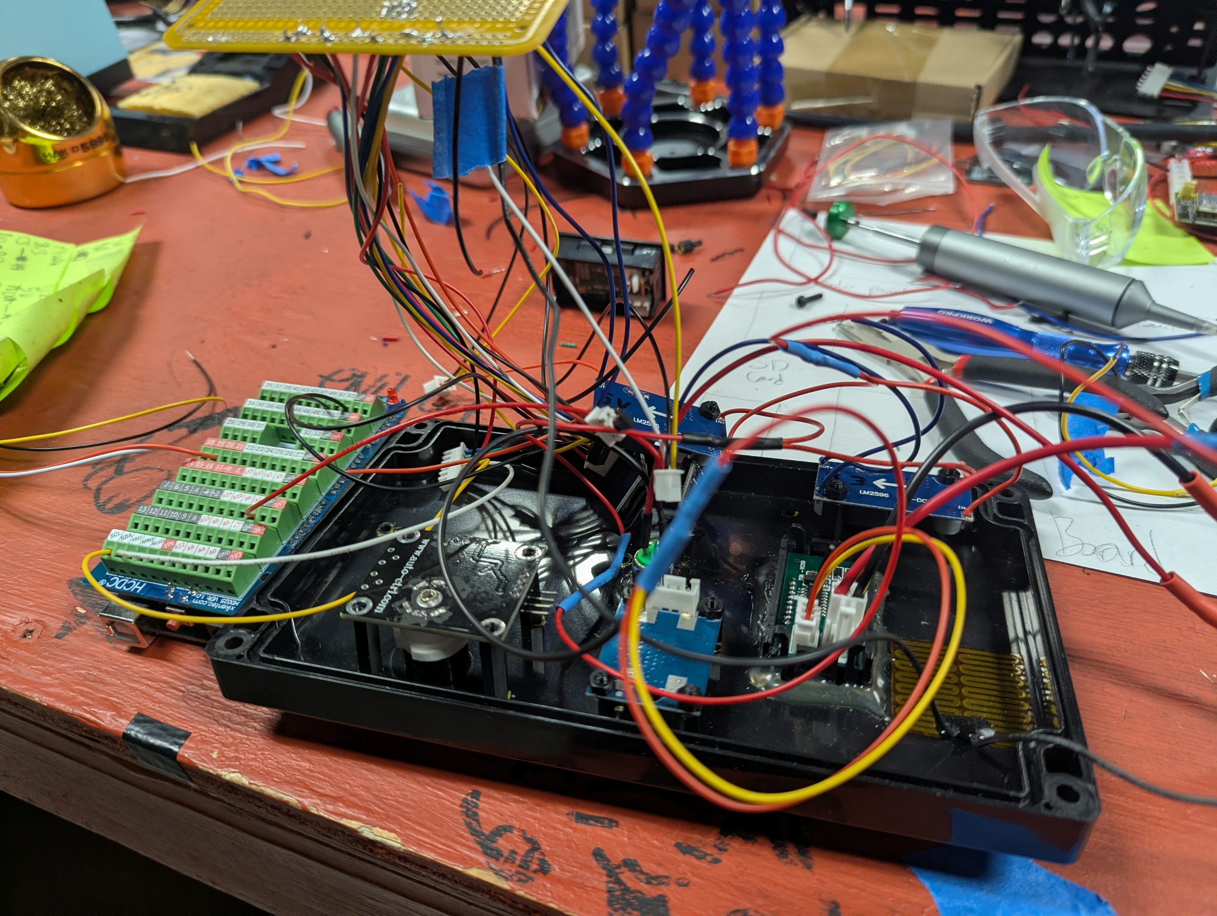
Fall 2025
7/24

Slide 8
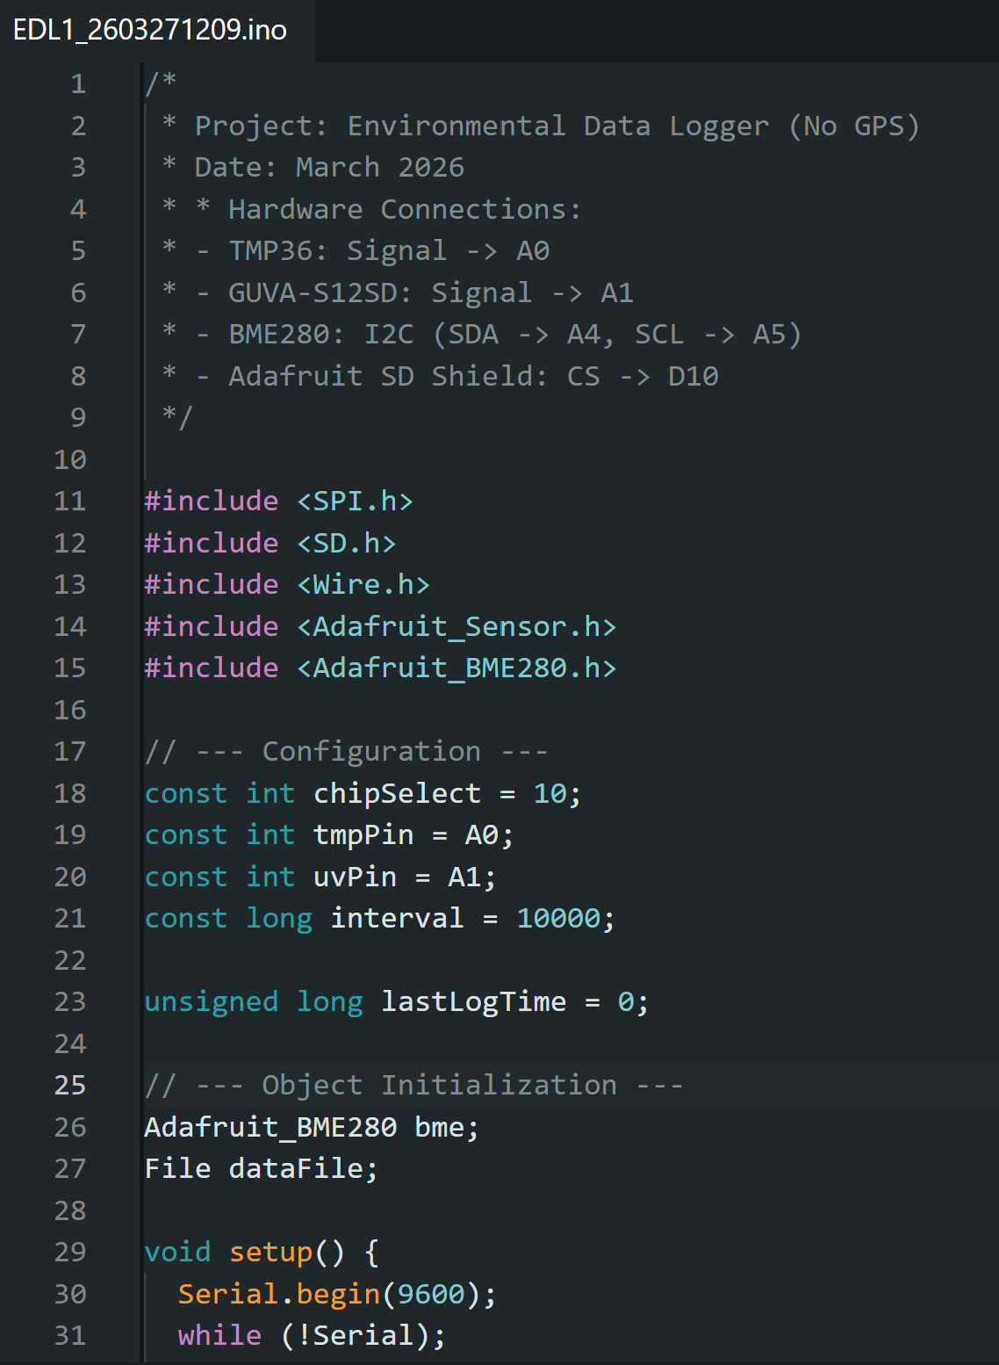
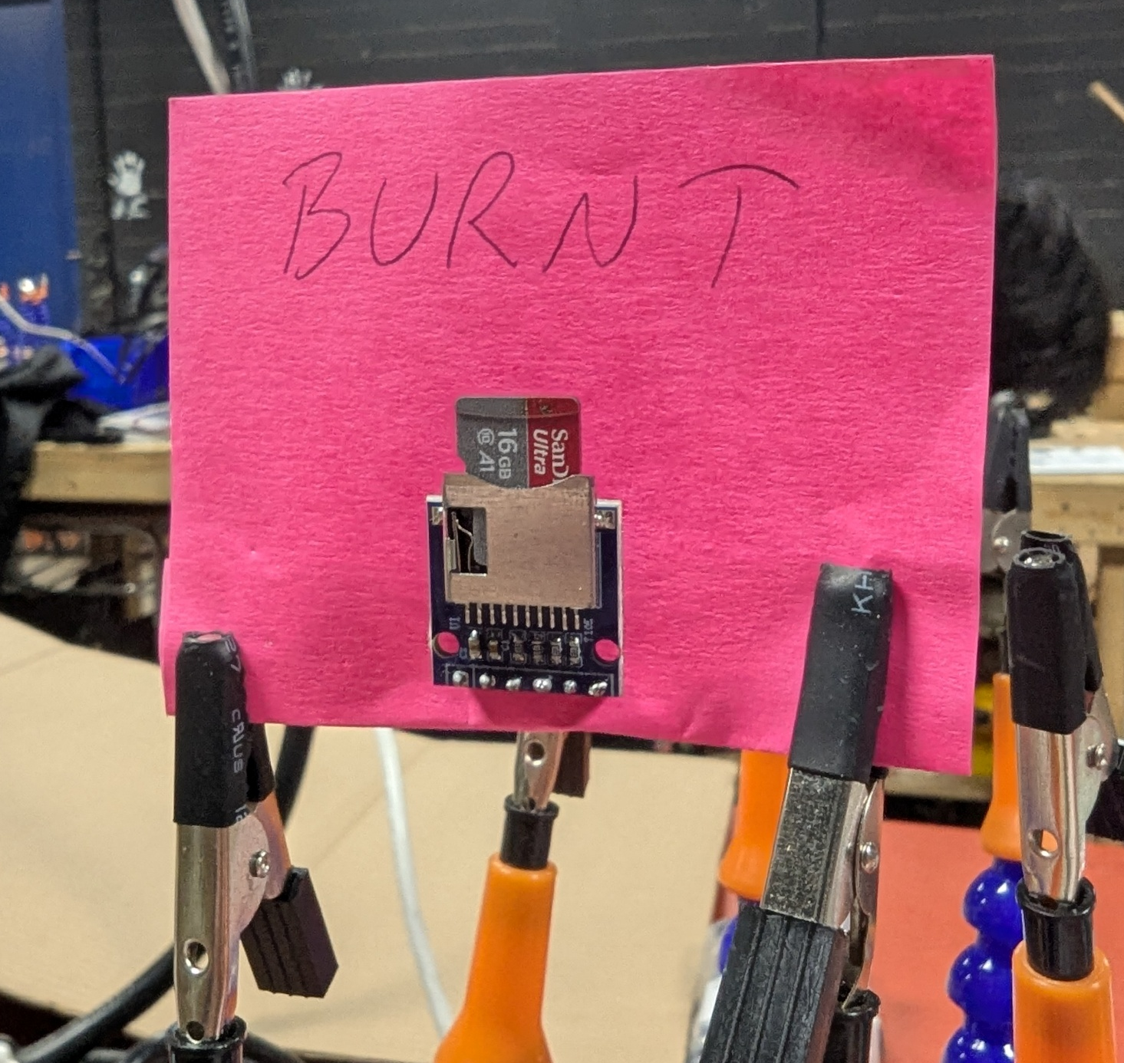

Arduio Code: C++
8/24

Slide 9
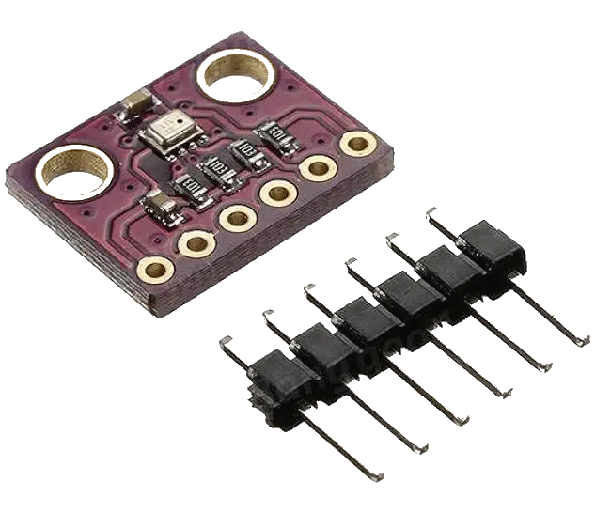
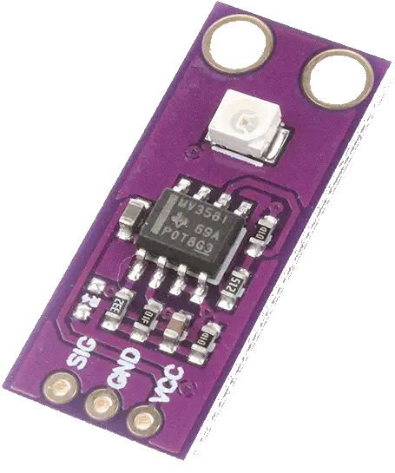
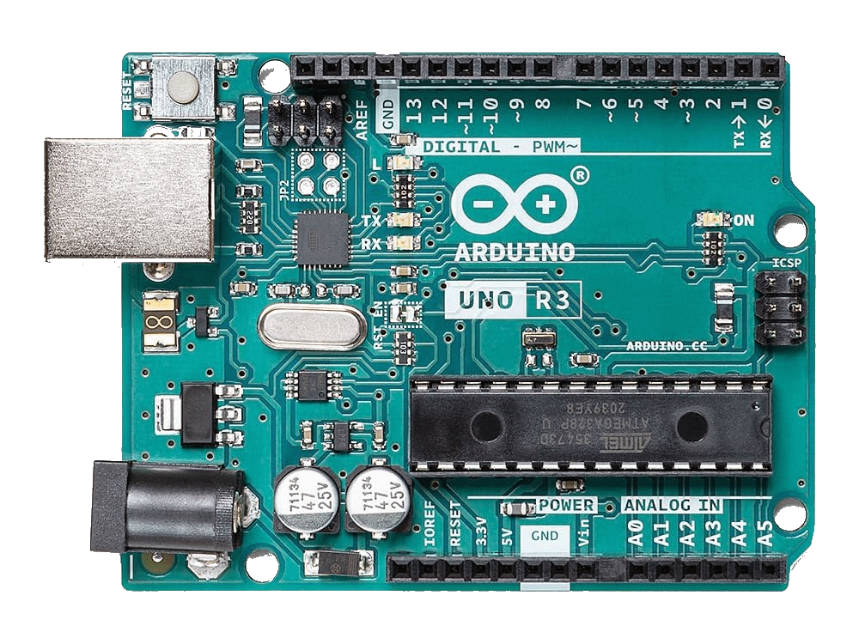
Advanced Engineering, Spring 2026
Re-evaluation
Transition from rapid development to "solid foundation.“
Emphasized reliability and rigorous bench testing.
Enhanced System Design
Multi-Sensor Suite: Simultaneous data logging, BME280 (via I²C) and GUVA-S12SD UV
  Data Acquisition: Arduino Uno slaved to an Arduino Mega (Planned, not realized)
  Power Architecture: 9V - 1200 mAh Lithium battery pack, 5V/3.3V regulation
9/24

Slide 10
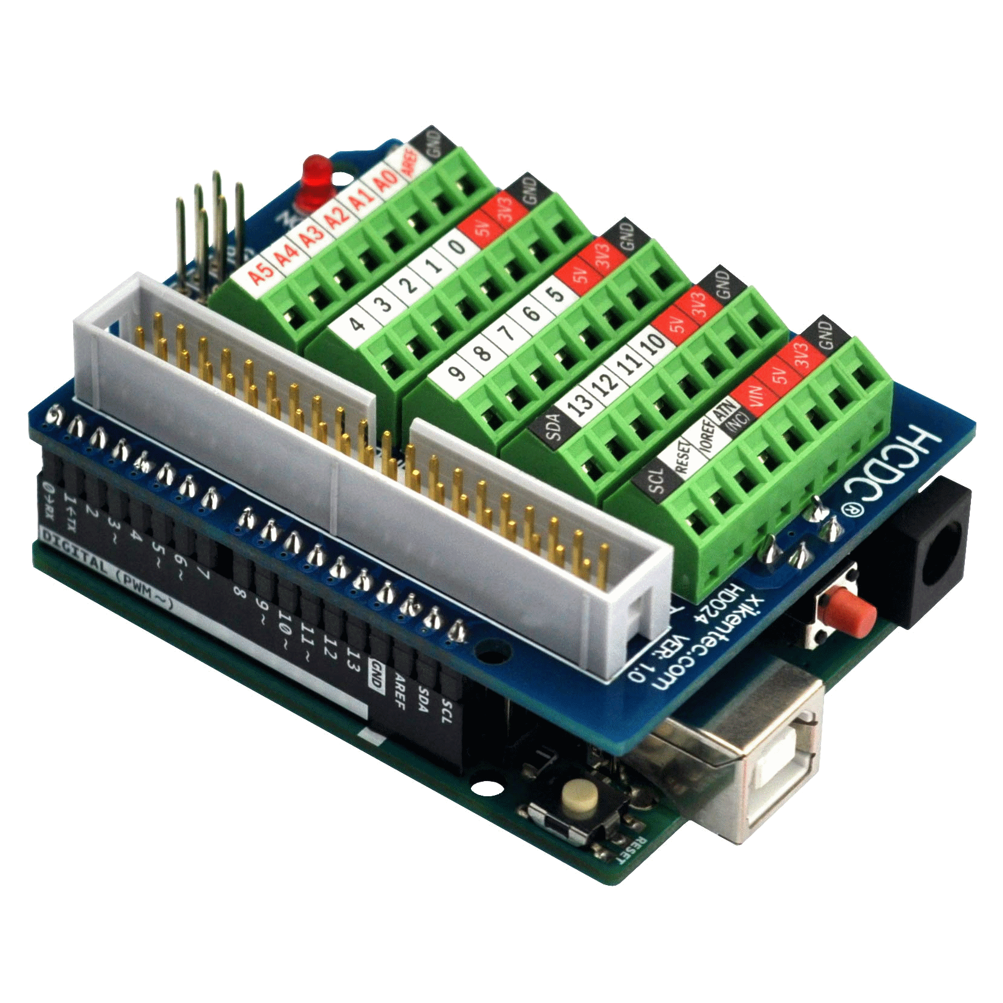
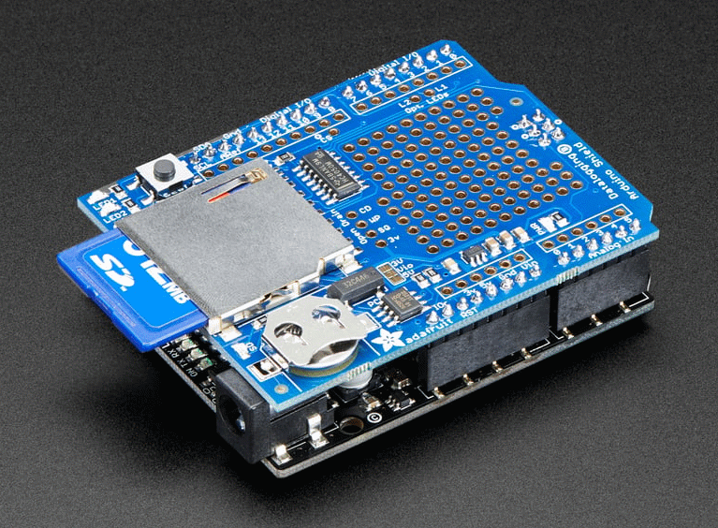
Our Solution: Arduino Uno +
Data Logging Shield + Screw Terminal Shield
10/24

Slide 11
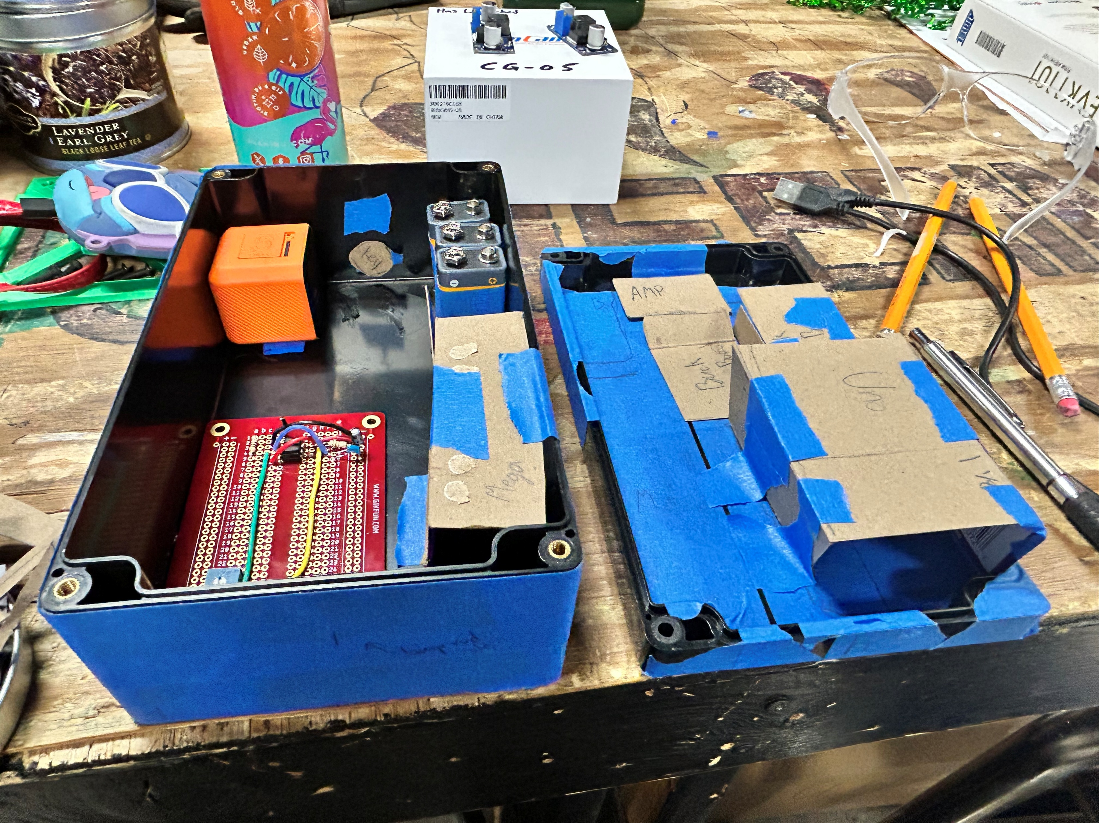
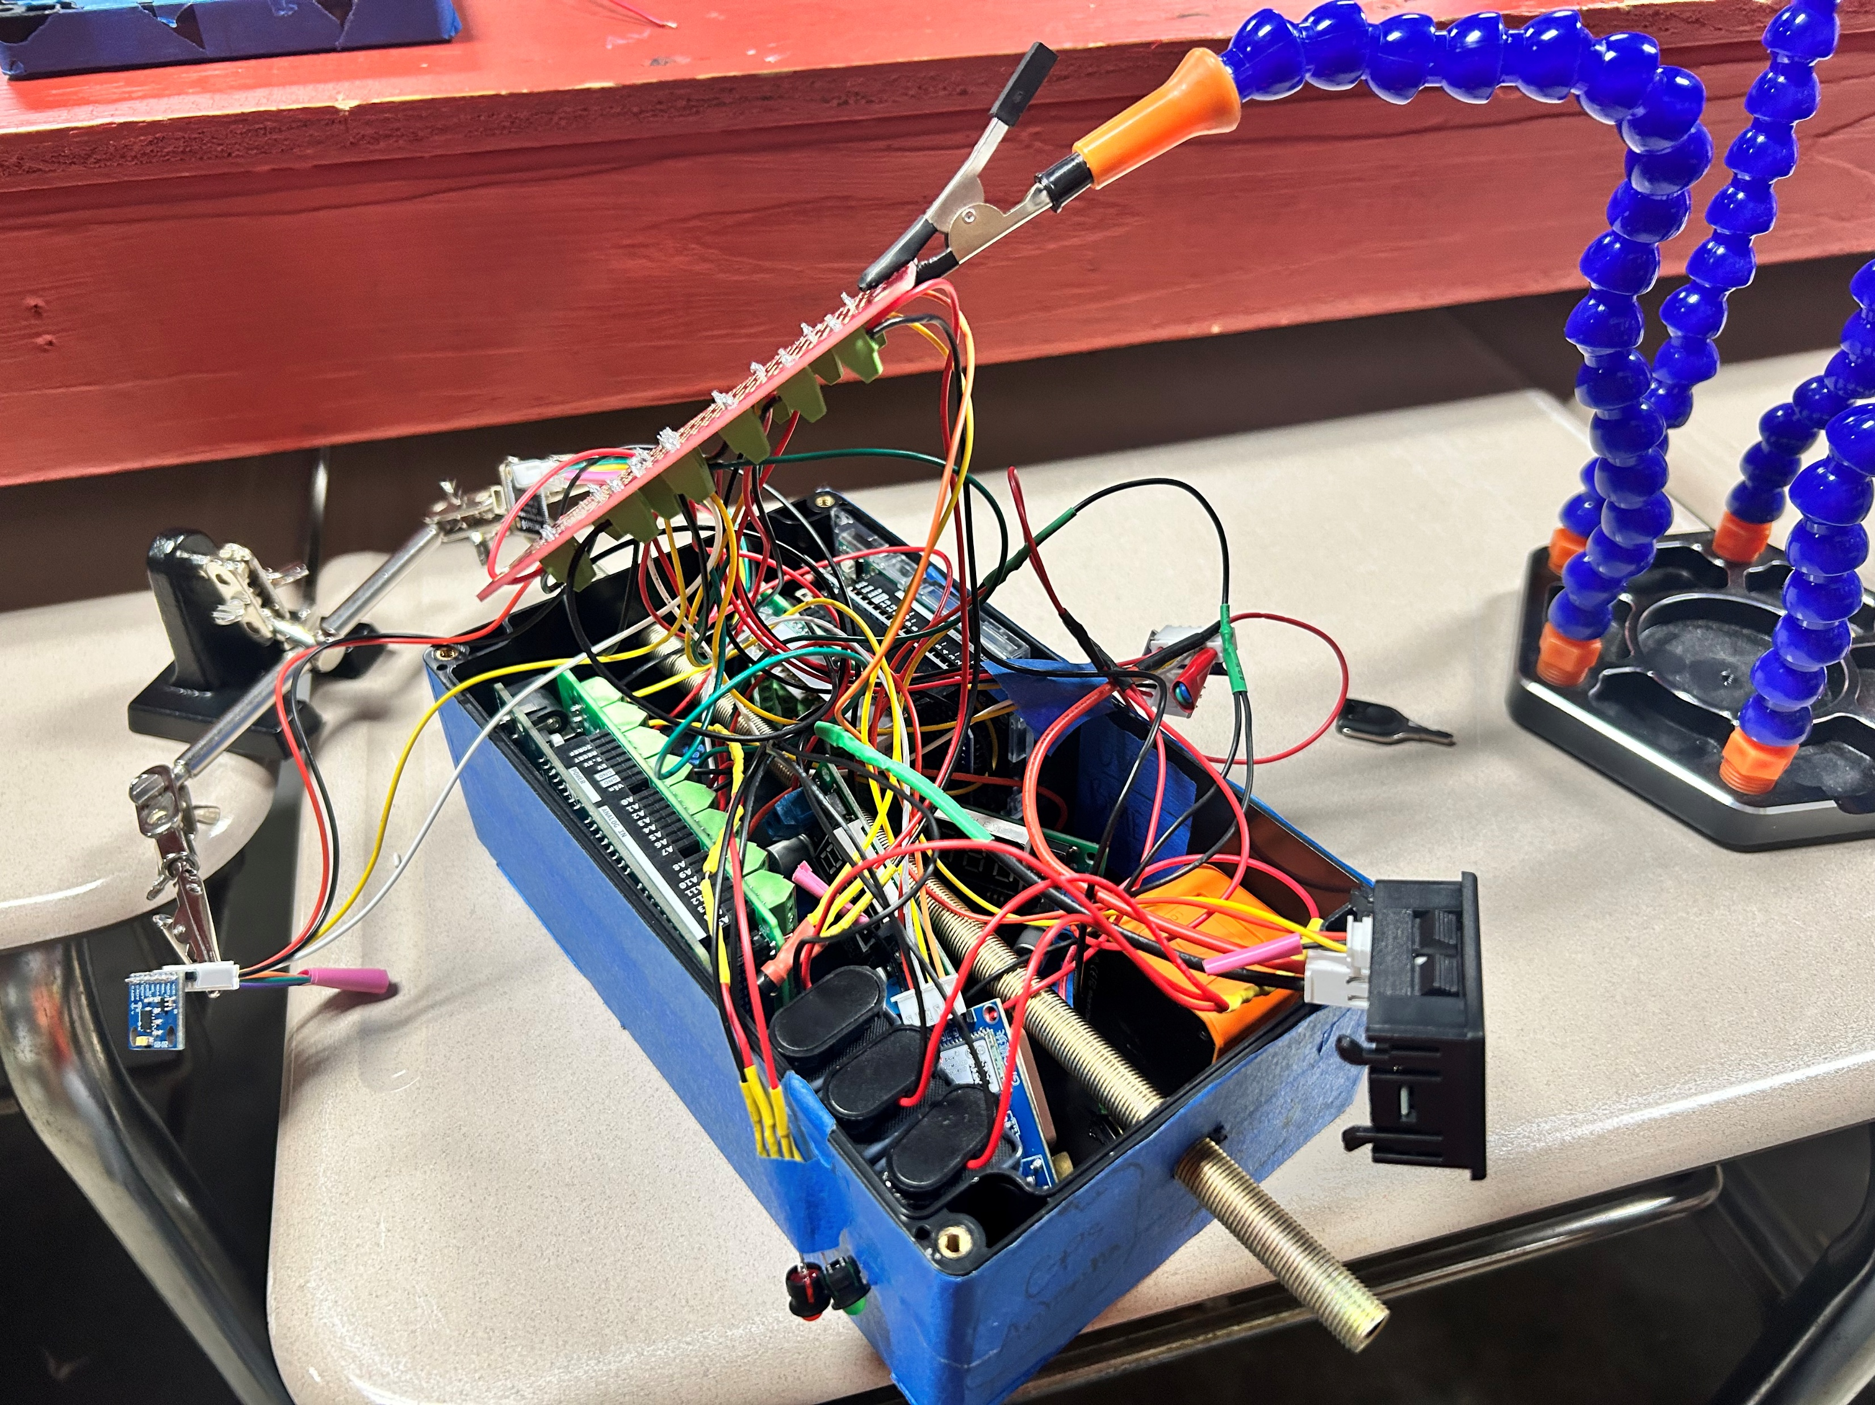
Spring 2026
11/24

Slide 12
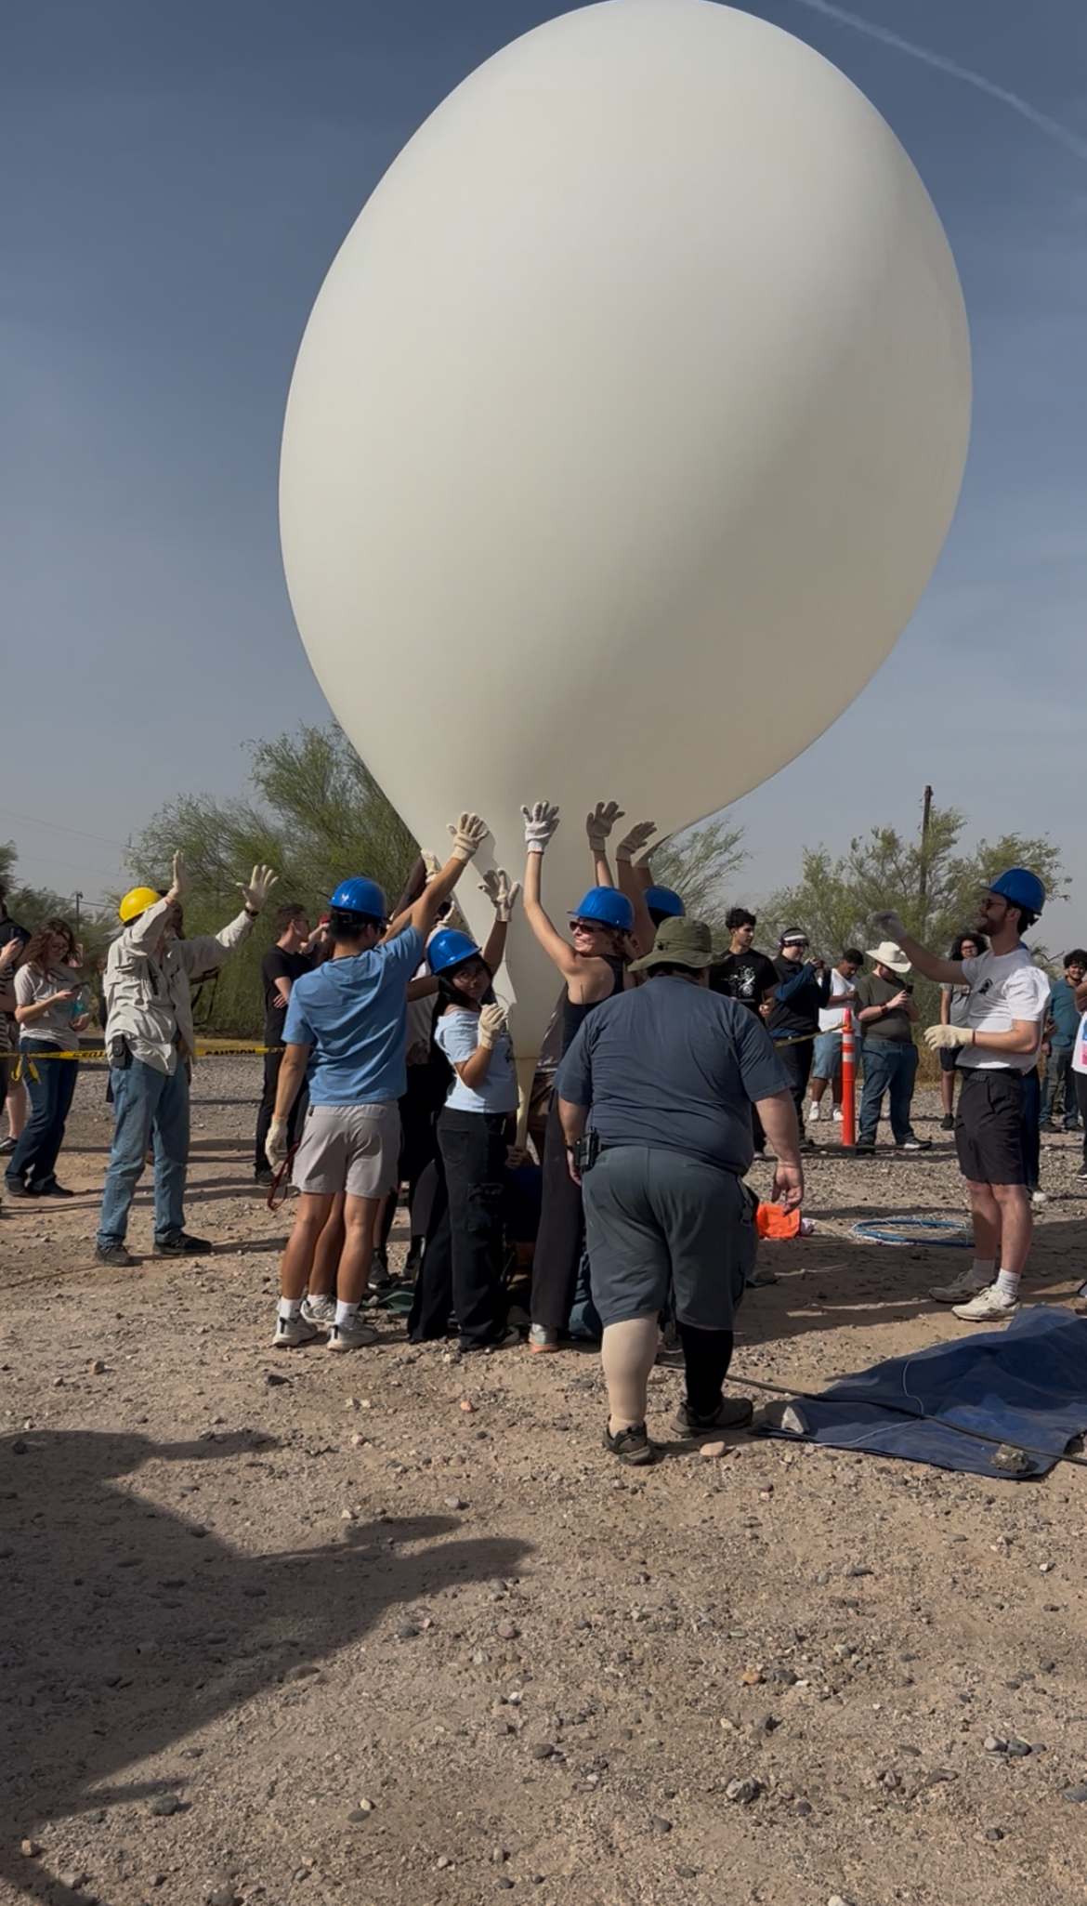
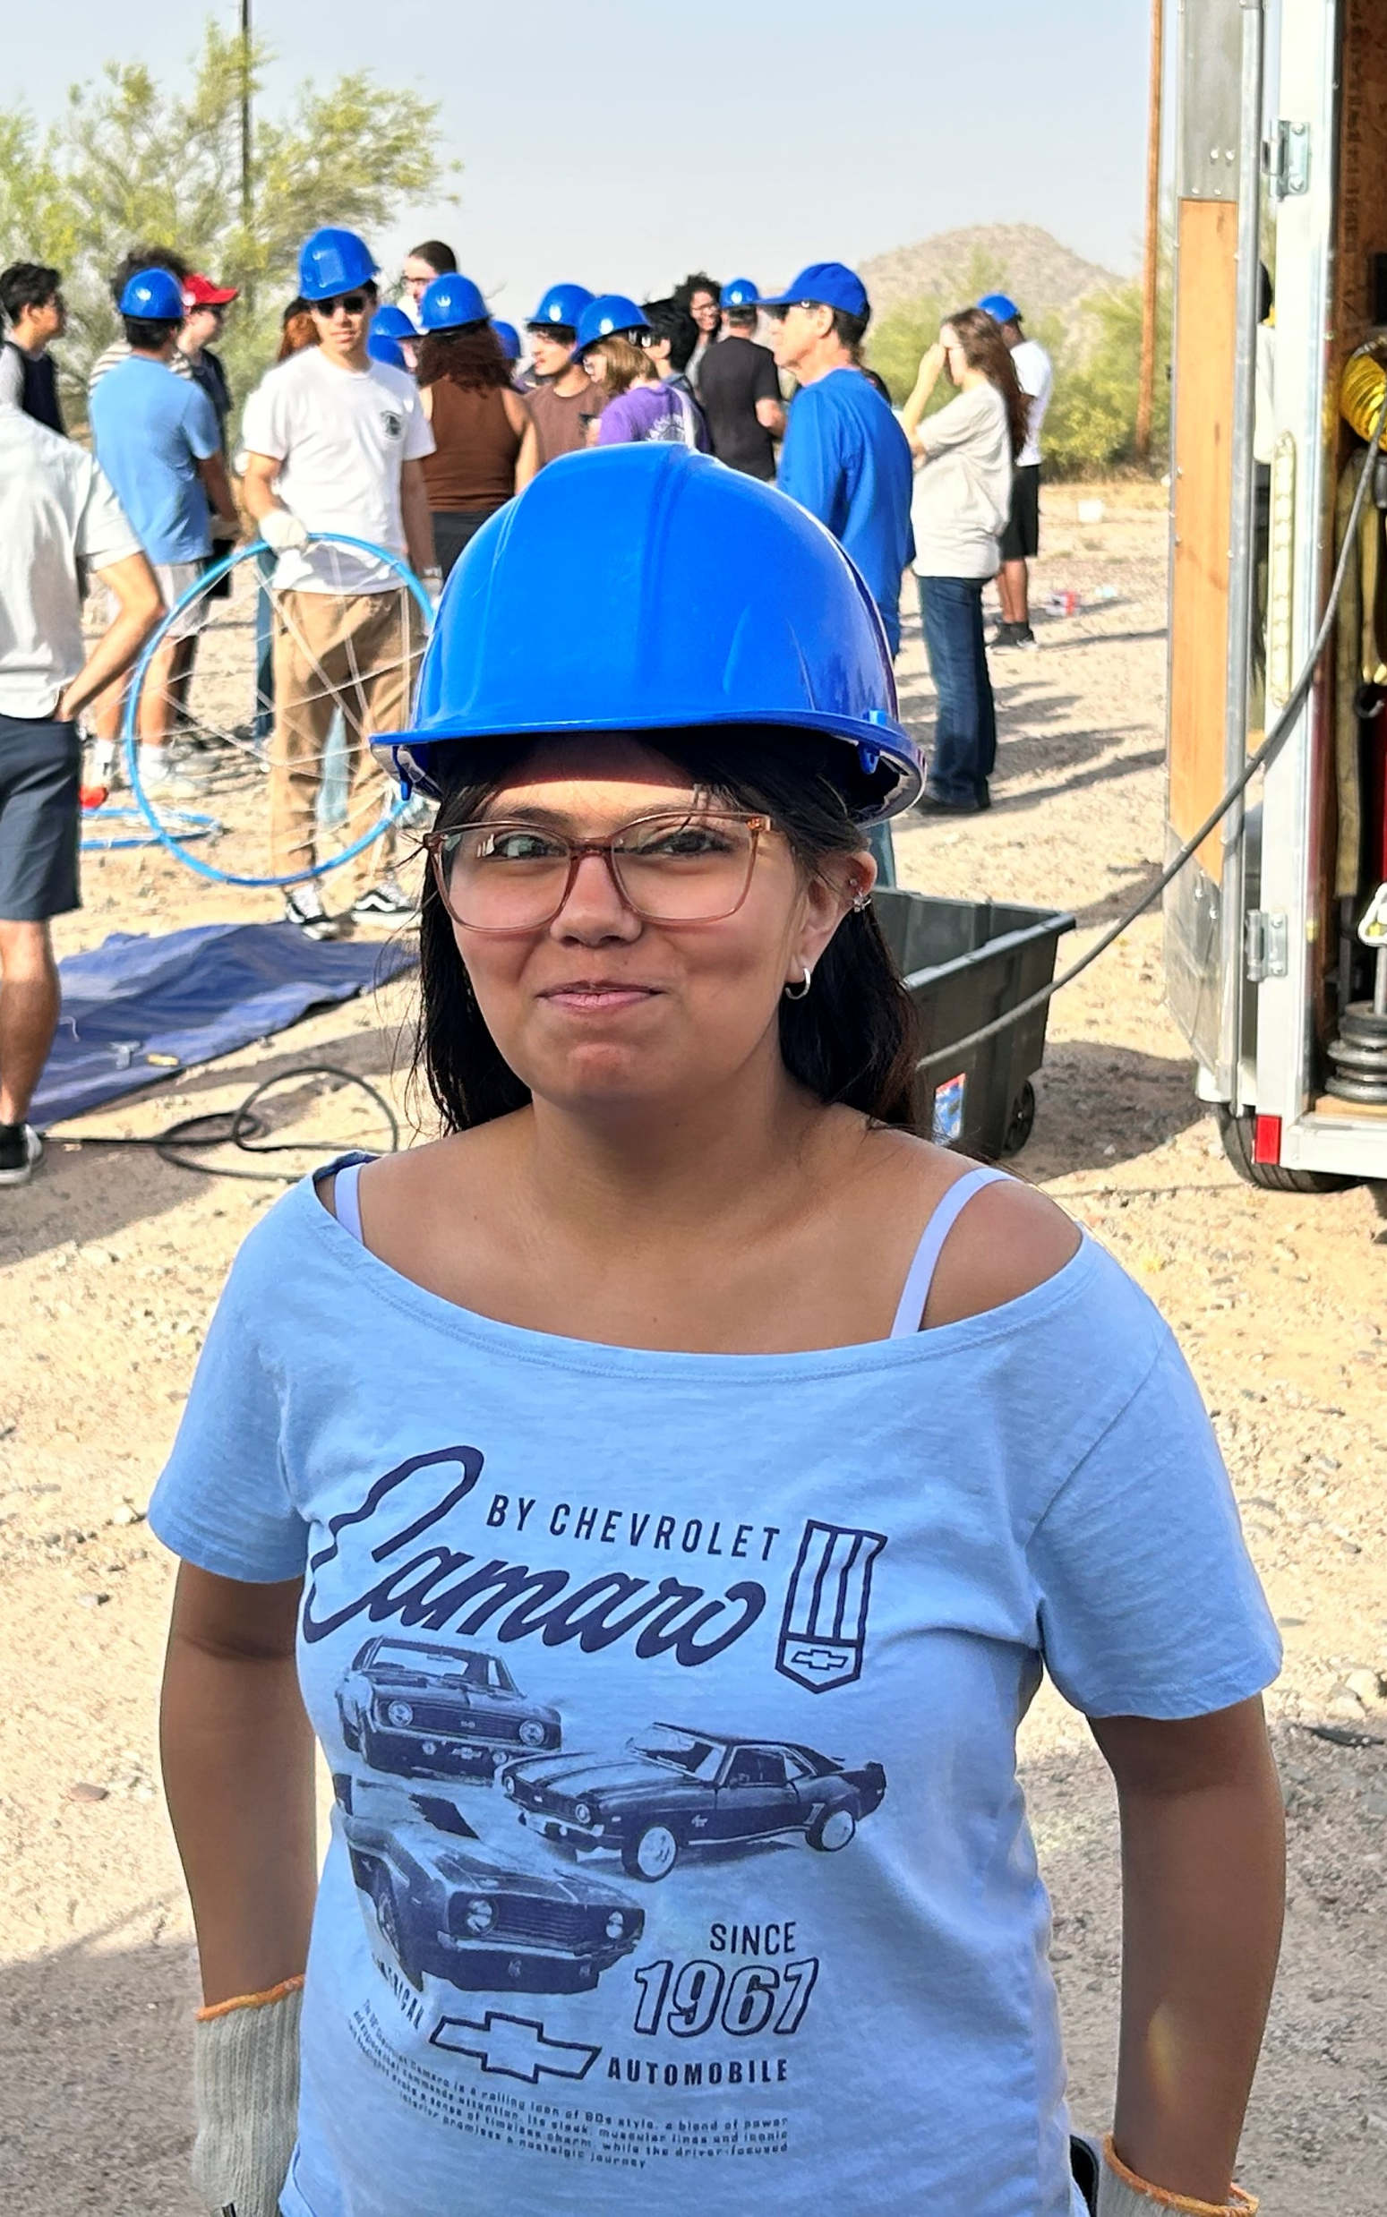
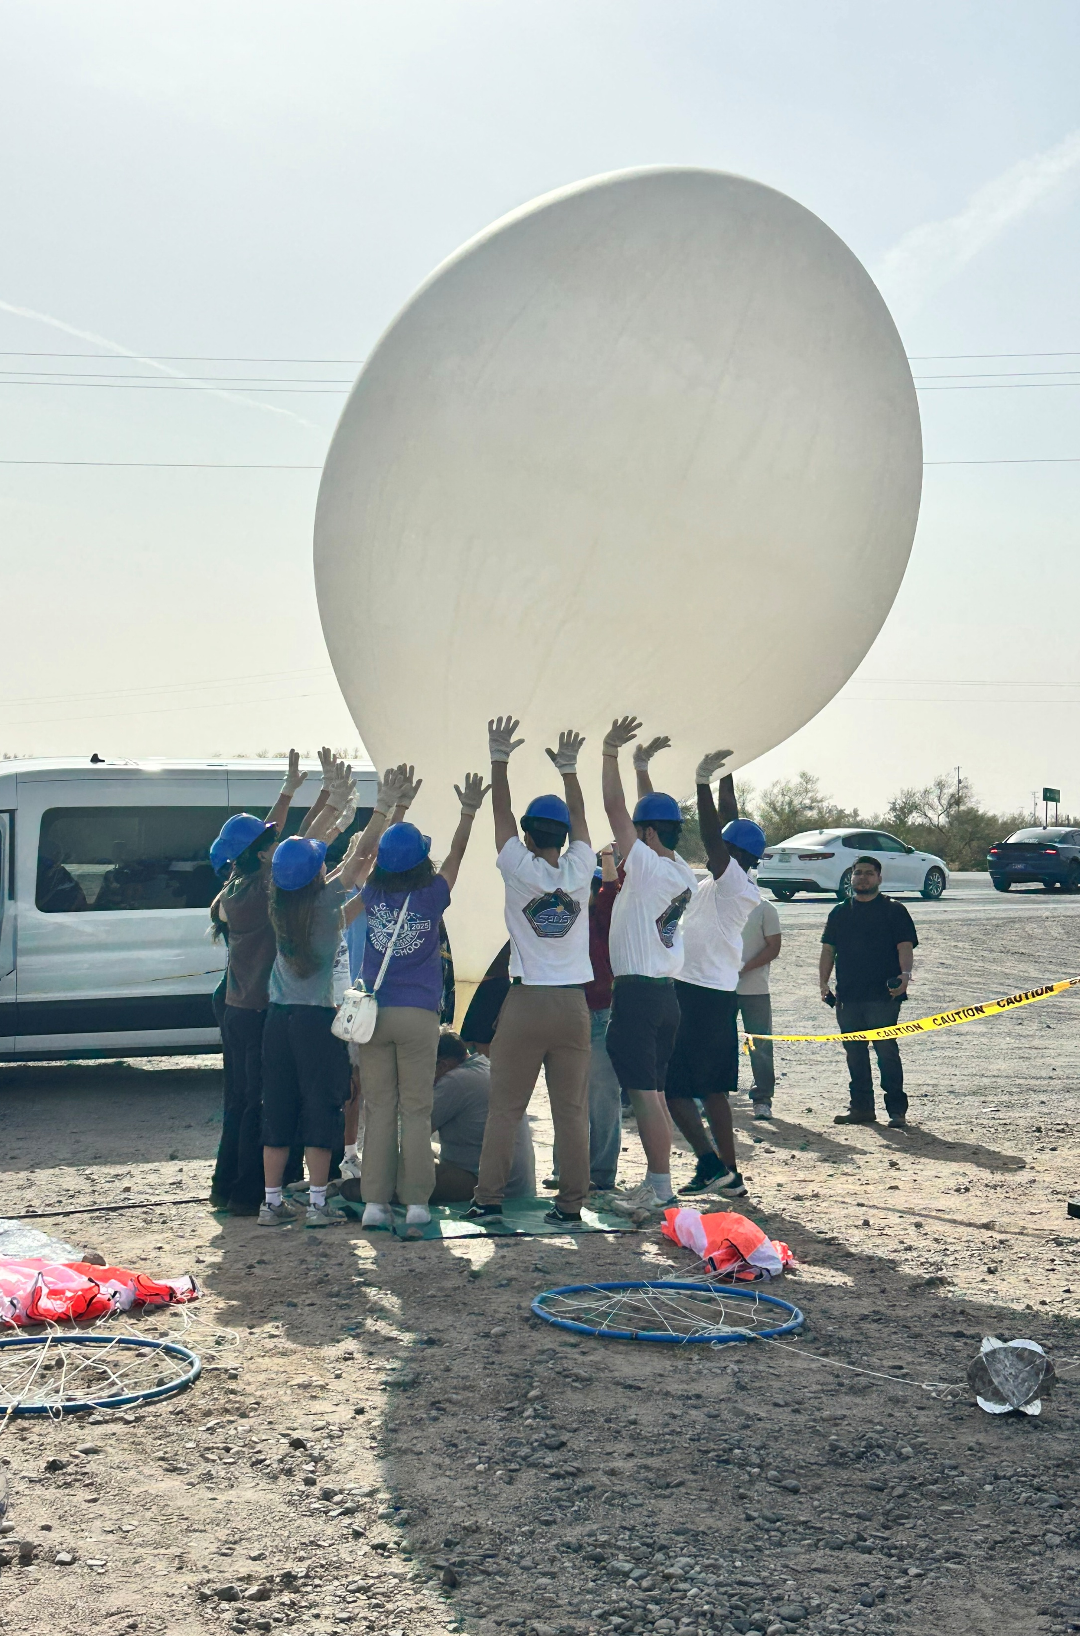
12/24

Slide 13
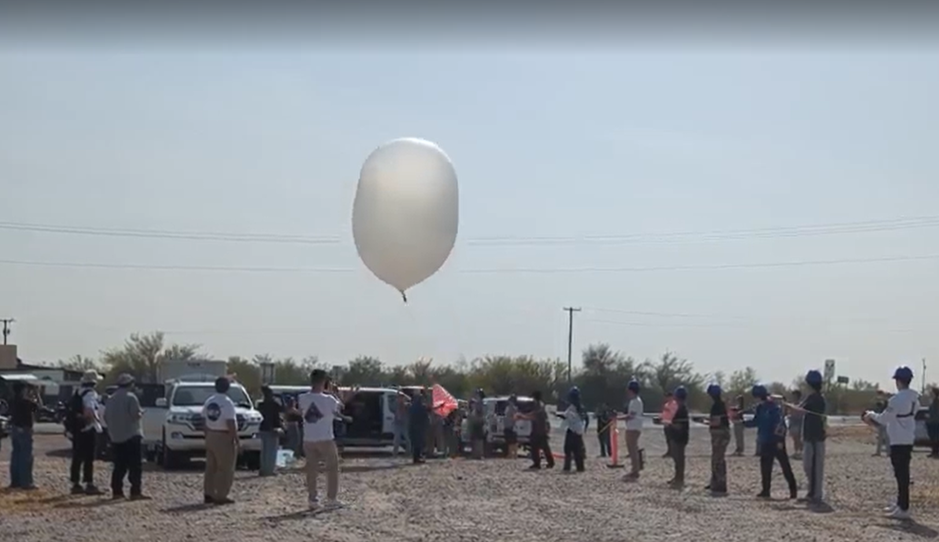

Slide 14
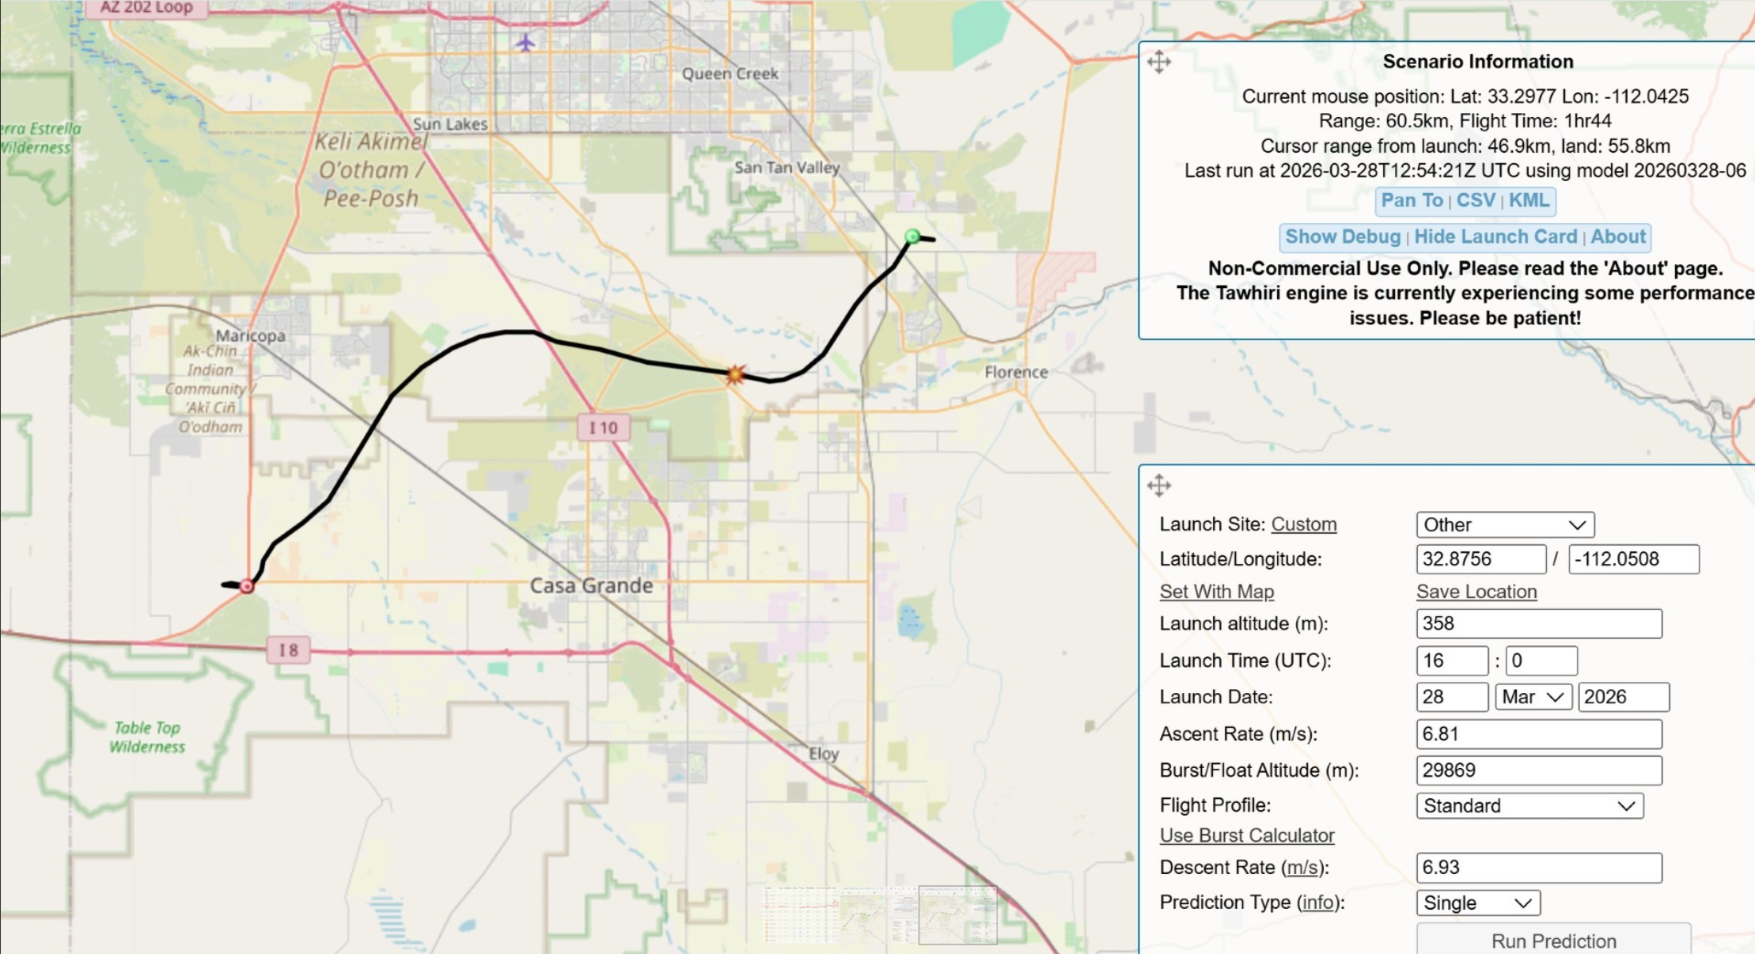

ASCEND! – Flight 60
Altitude achieved: 76280 ft
It landed near the SE corner of the San Tan Park and Gila Reservation line.
14/24

Slide 15
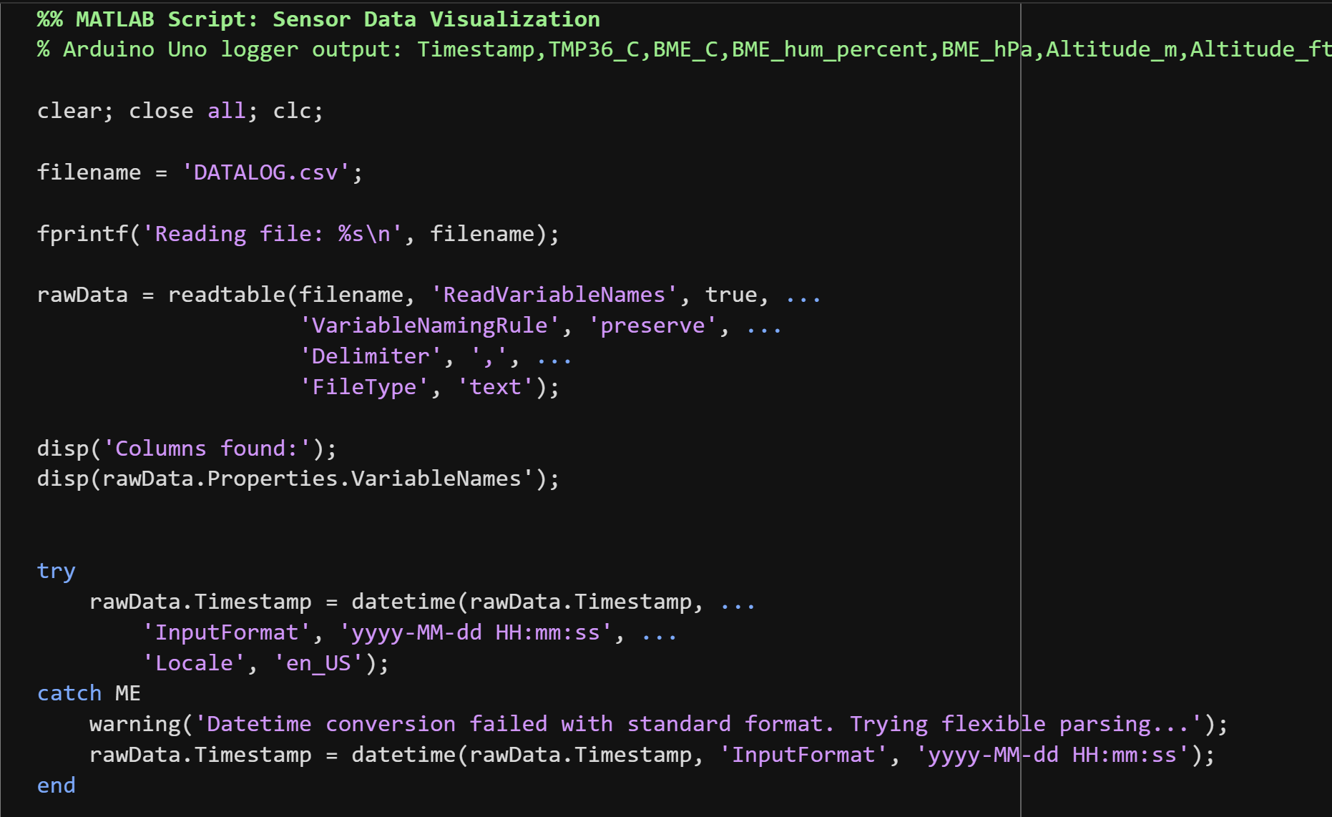
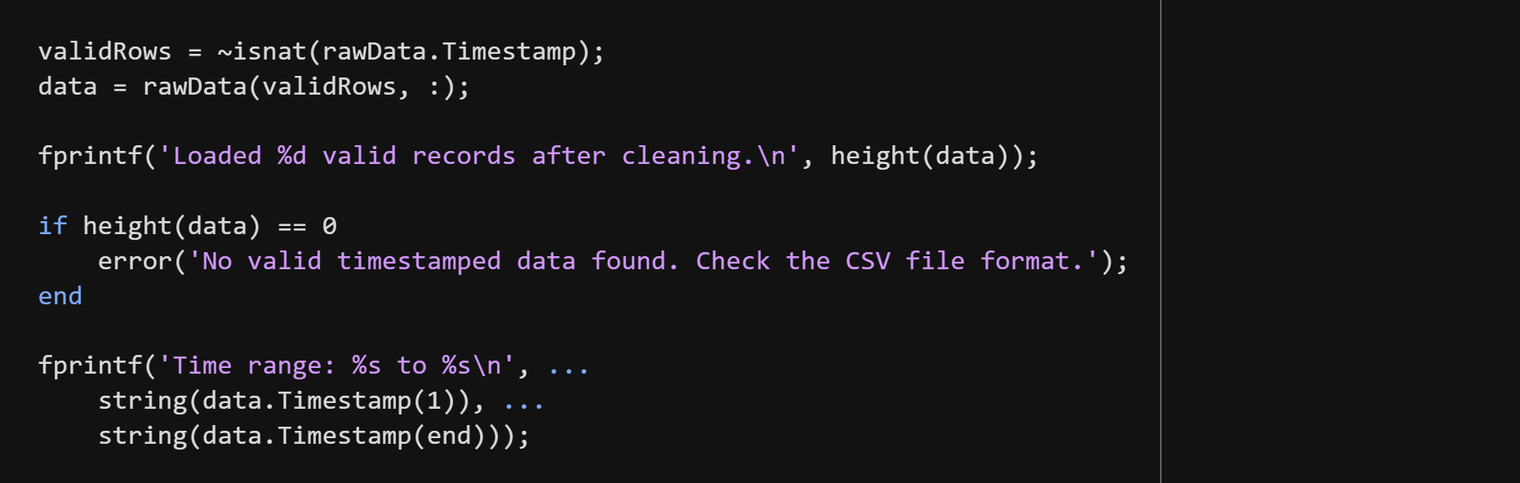

MATLAB DATA ANYALSIS AND RESULTS
Data Analysis Methodology
Objective: Convert unprocessed high-altitude telemetry data to verified scientific results.
  Data Import
  Data Verification
  Multi-Dimensional Visualization
15/24

Slide 16
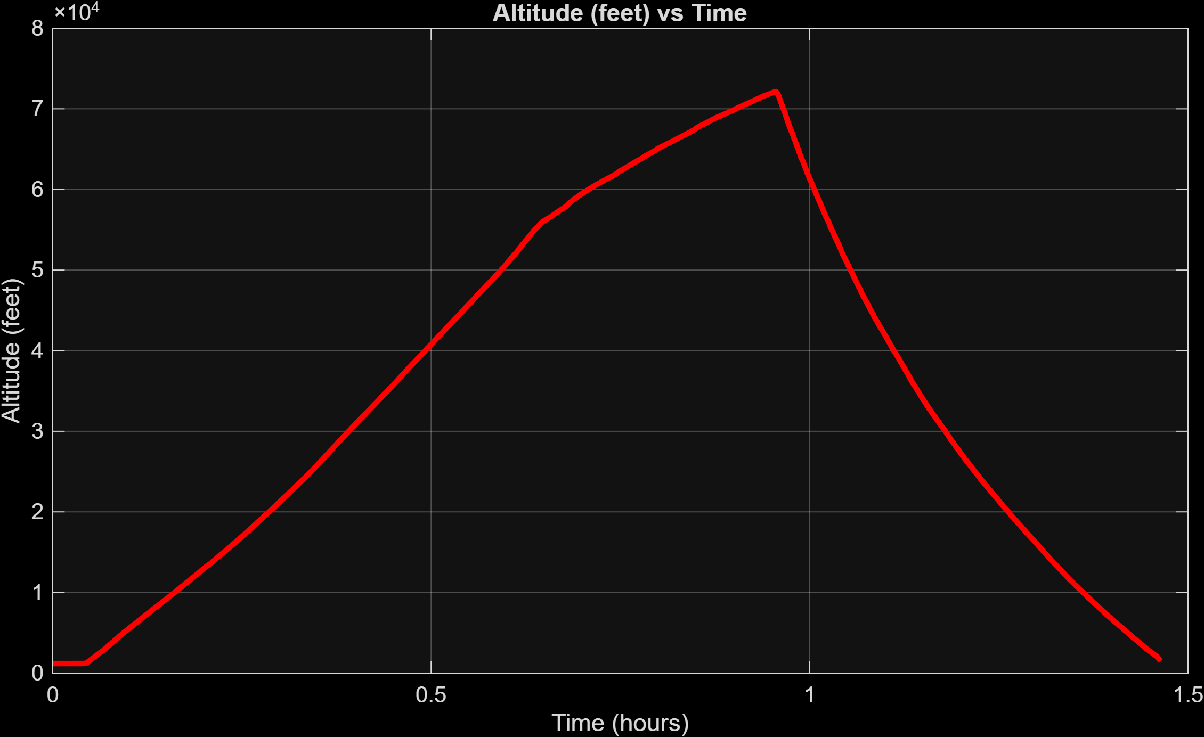
16/24

Slide 17
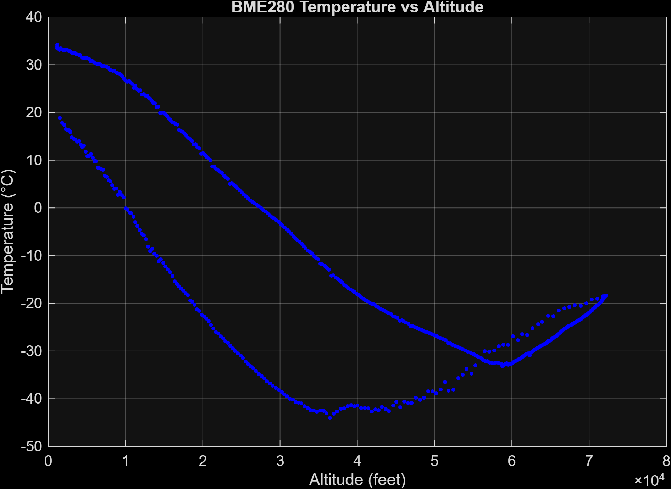
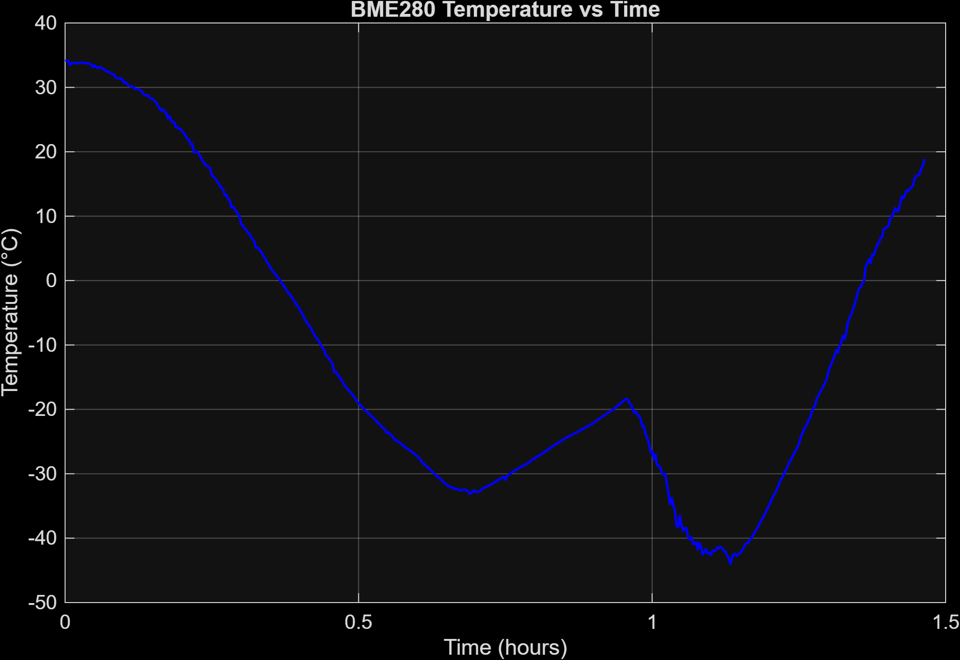
17/24

Slide 18
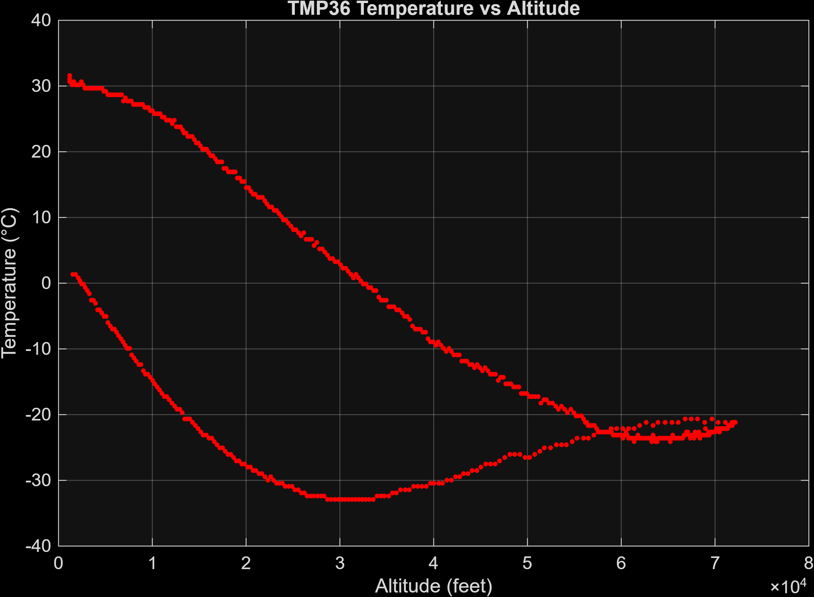
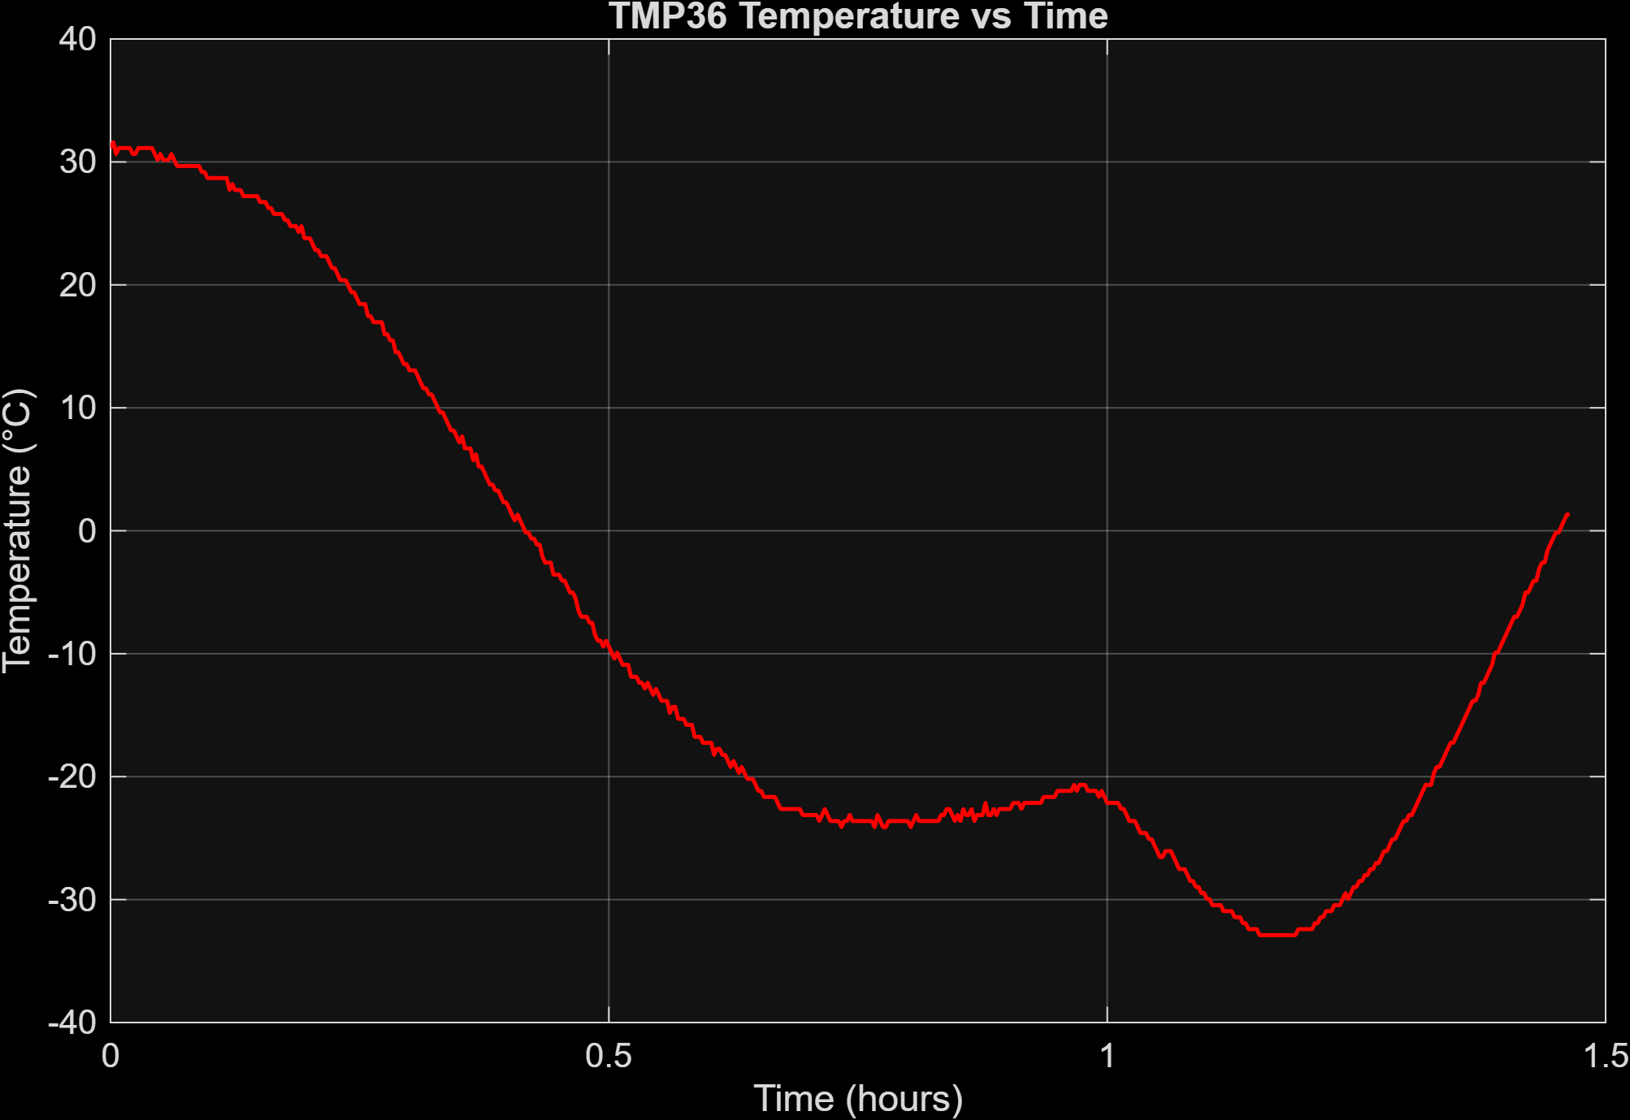
18/24

Slide 19
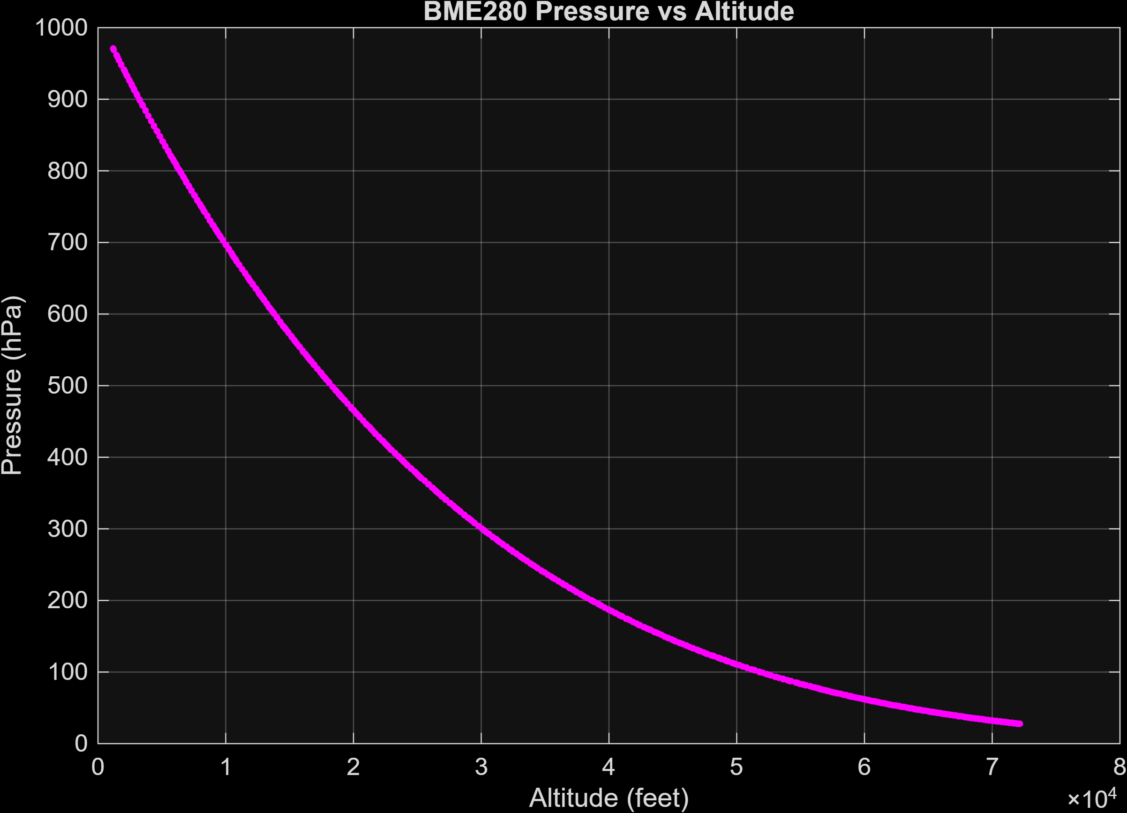
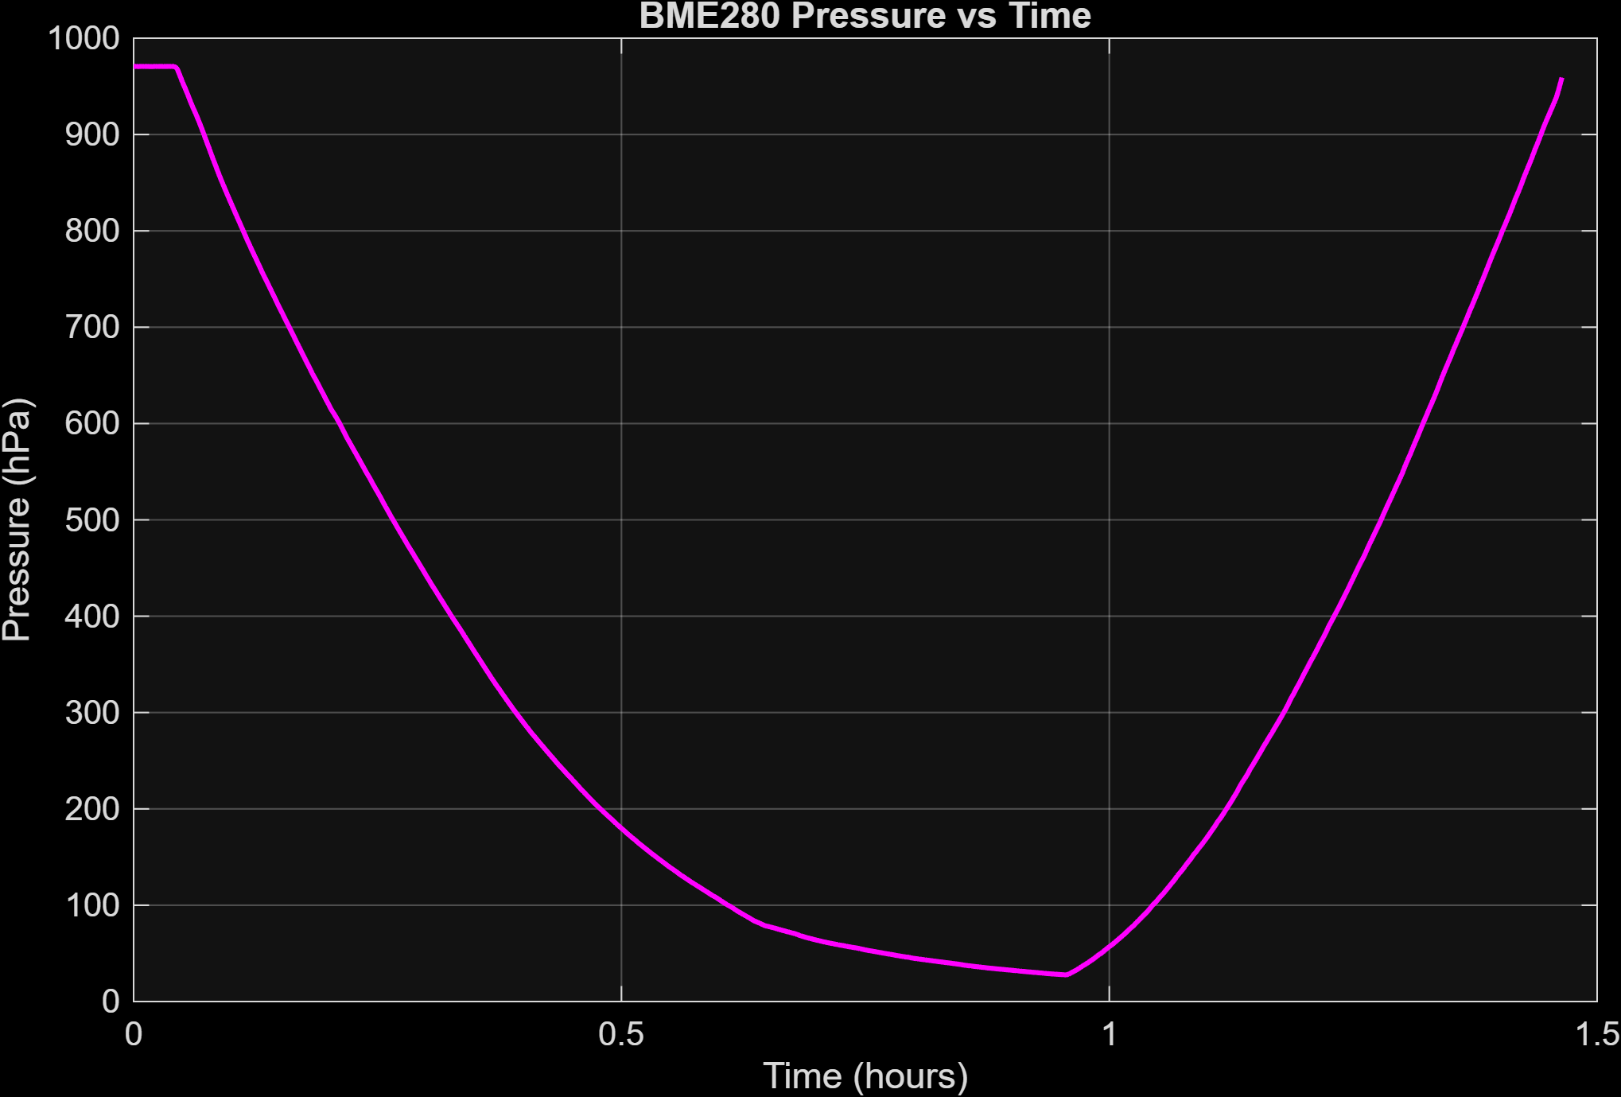
19/24

Slide 20
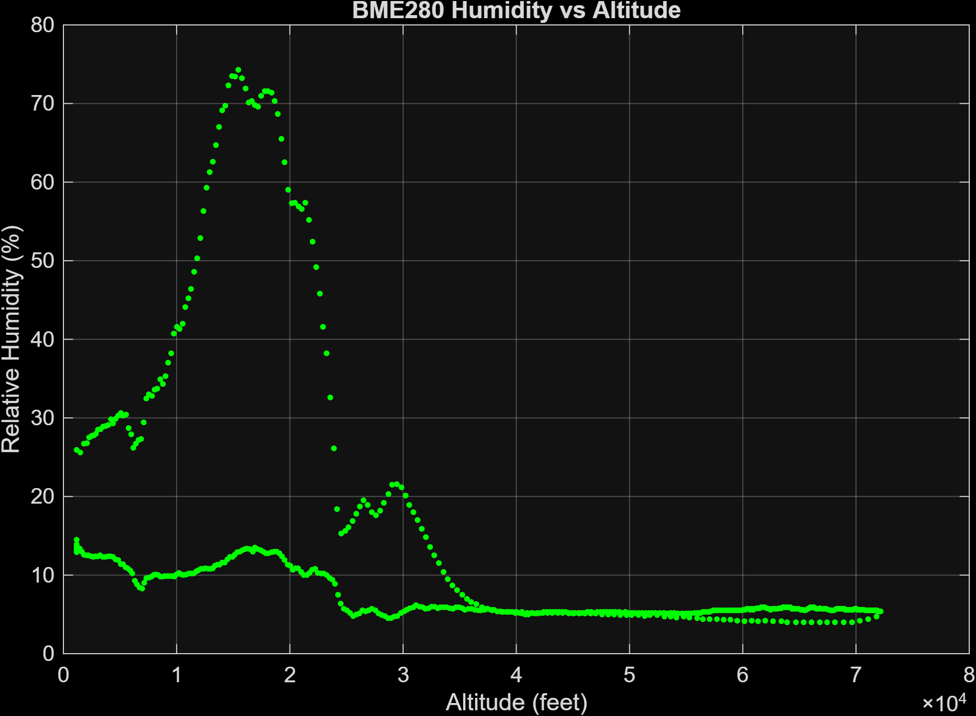
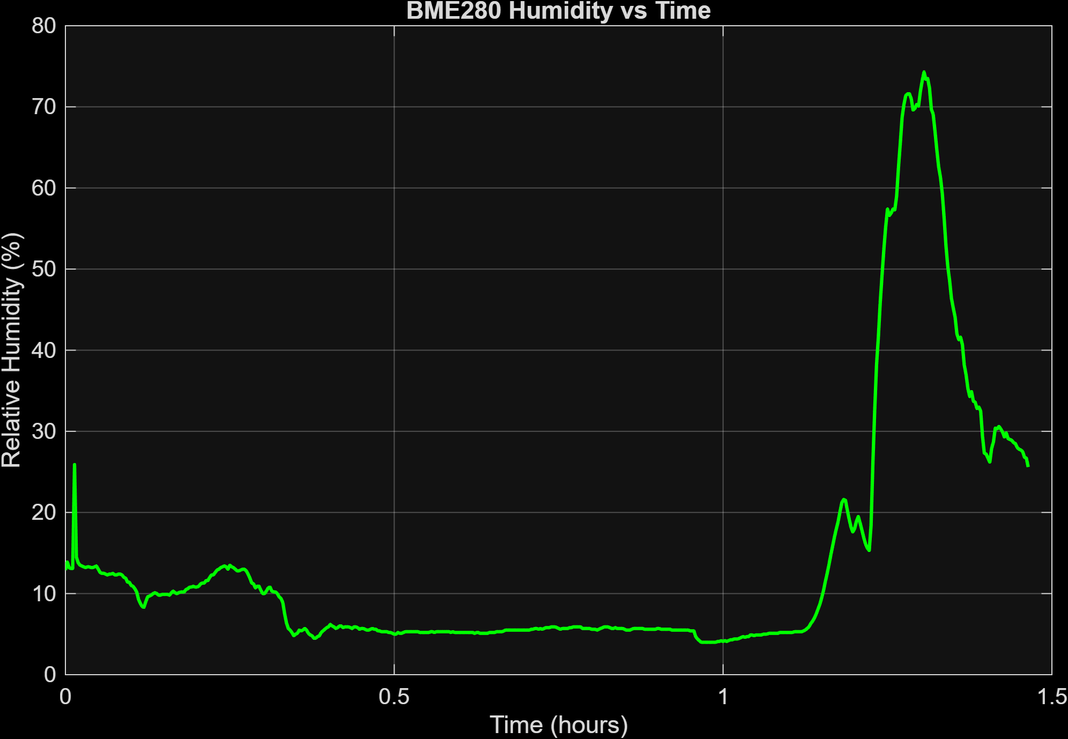
20/24

Slide 21
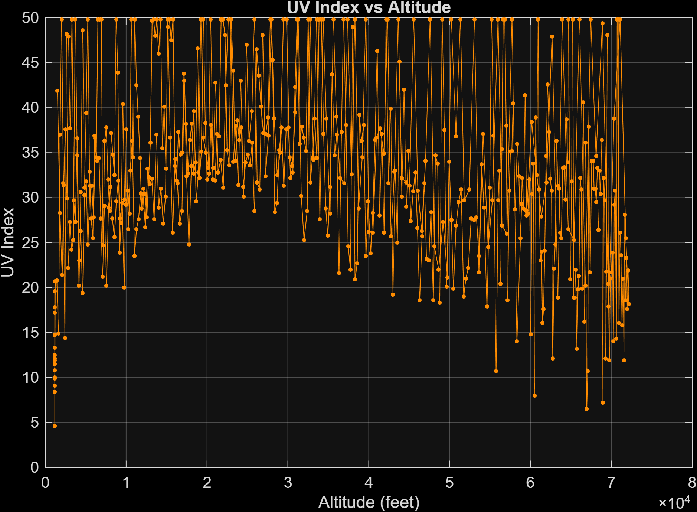
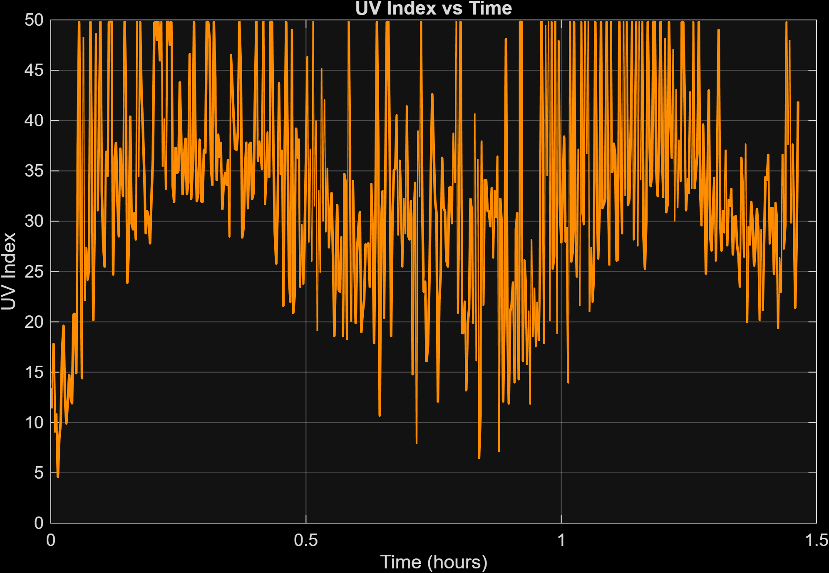
21/24

Slide 22
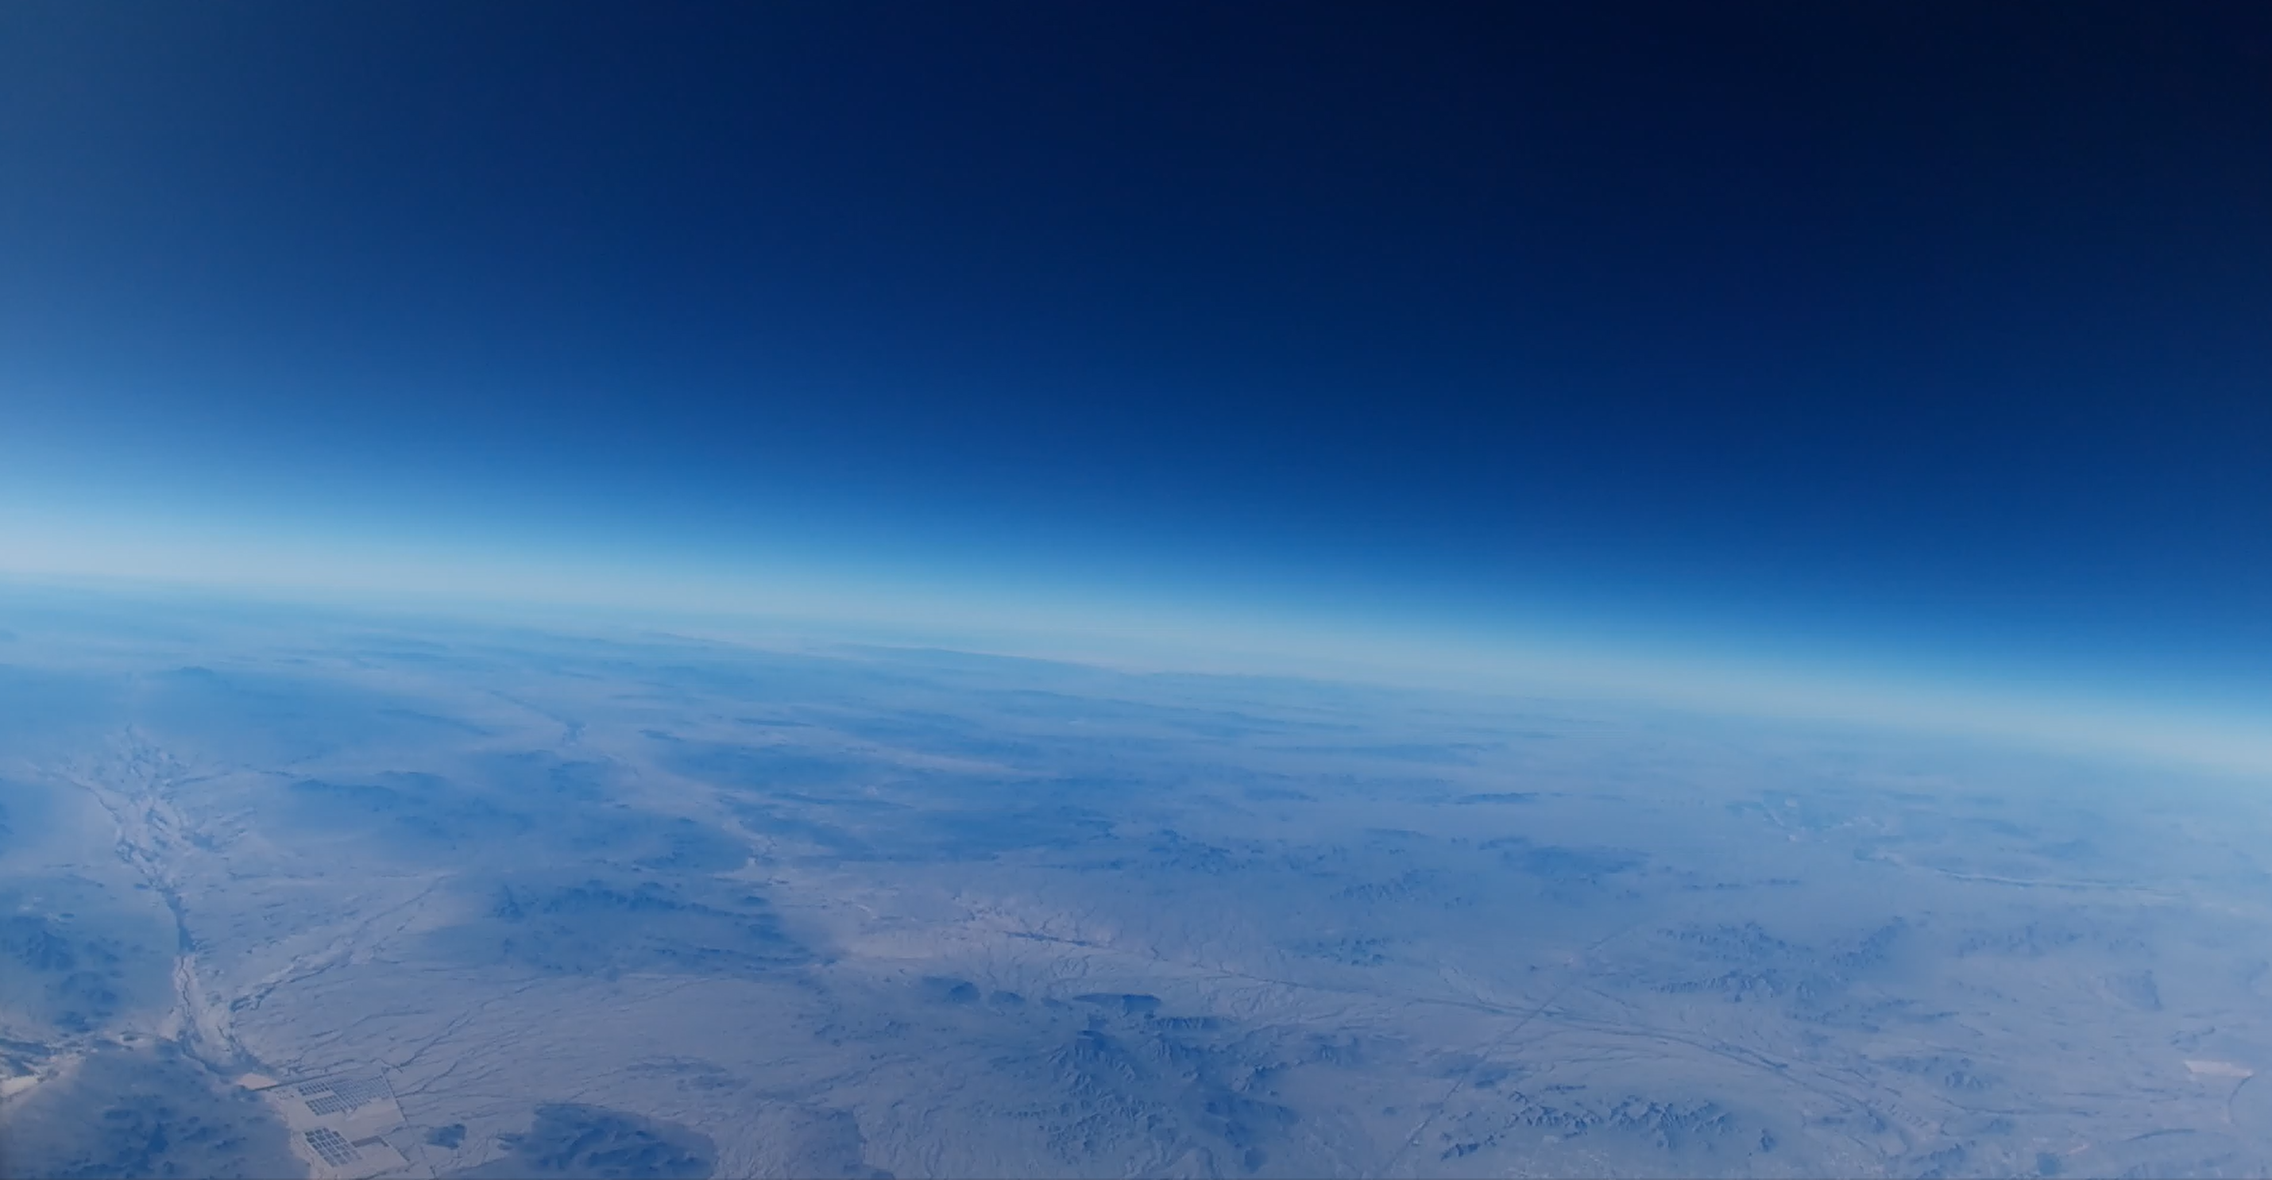

Slide 23
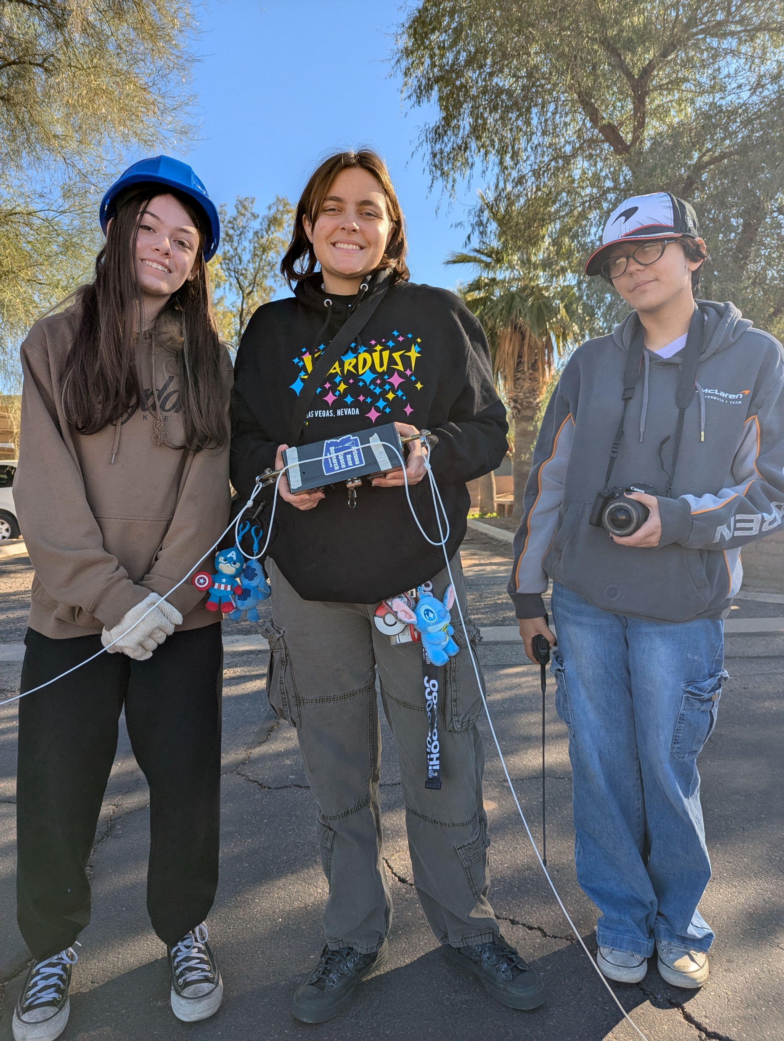
Conclusions & Future Outlook
Reliability Over Complexity
Incremental Development
Educational Impact

